Slide 1

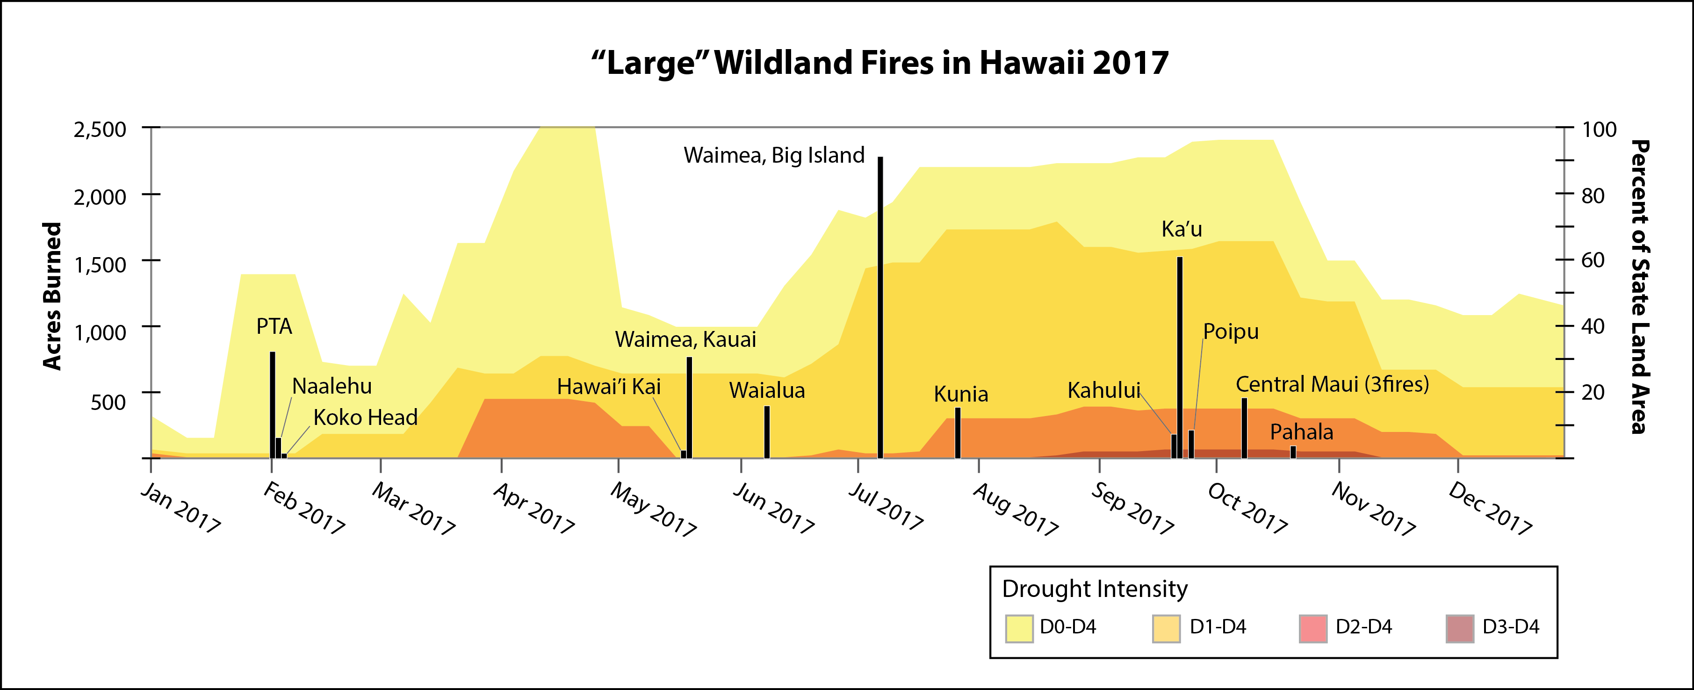
2017 Annual Review of Wildfires in Hawaii

Slide 2

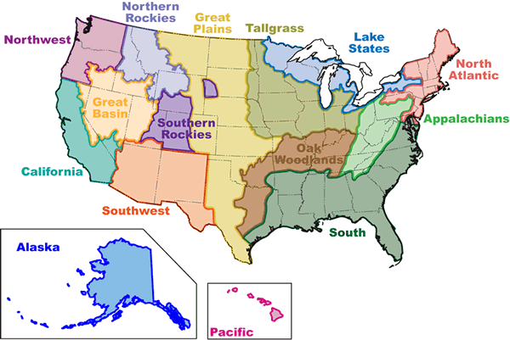
The Joint Fire Science Program (JFSP)
& Fire Science Exchange Network
JFSP: Research Supporting Sound Decisions
www.firescience.gov
The Fire Science Exchange Network

Slide 3





The Pacific Fire Exchange
Founding Partners:

Slide 4


The Pacific Fire Exchange
Goal: Reduce wildfire threats to ecosystems and communities in the Pacific
Facilitate knowledge exchange
Enable collaborative relationships
Leverage best available research
Visit us online!
Products & Activities:
Webinars
Field Trips
Workshops
Fact Sheets
Research Briefs
Newsletter & Website
www.PacificFireExchange.org
@PacificFireSci

Slide 5
Help us better serve you!
Complete the feedback survey at the end of the webinar
Mahalo!

Slide 6
2017 Annual Review of Wildfires in Hawaii
Objectives:
Review significant wildfire events of 2017
- Climate/weather factors
- Fuel types and vegetation burned
Get feedback
- Lessons learned from response
- Resource vulnerability concerns
- Others?

Slide 7
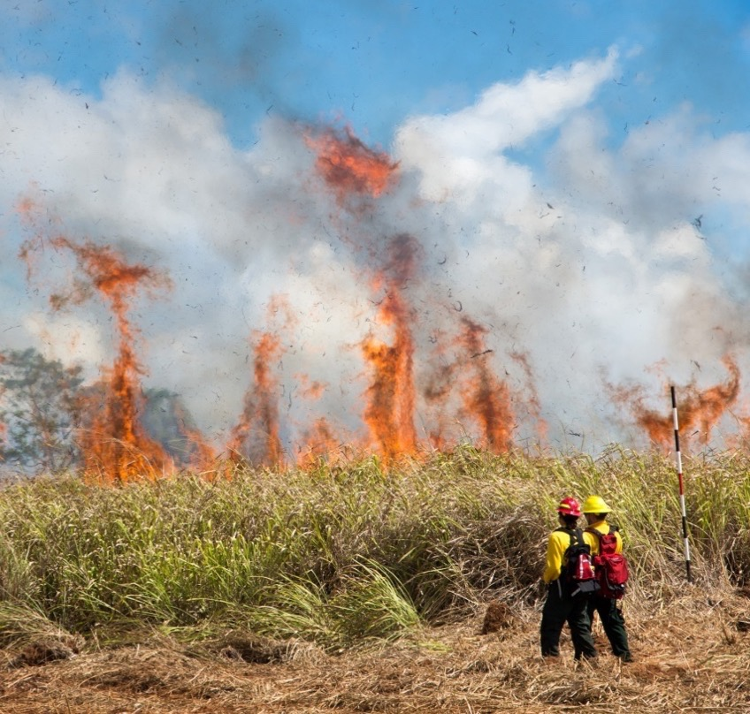
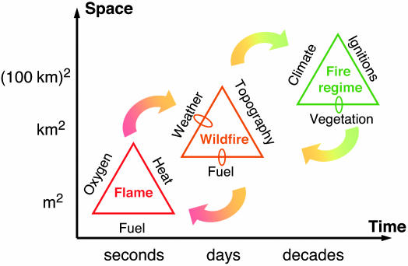
Fire regimes
Moritz et al. 2005. Proc. Natl. Acad. Sci.
Central Oahu 2013

Slide 8
Historical area burned in Hawaii
Central Oahu 2013

Slide 9
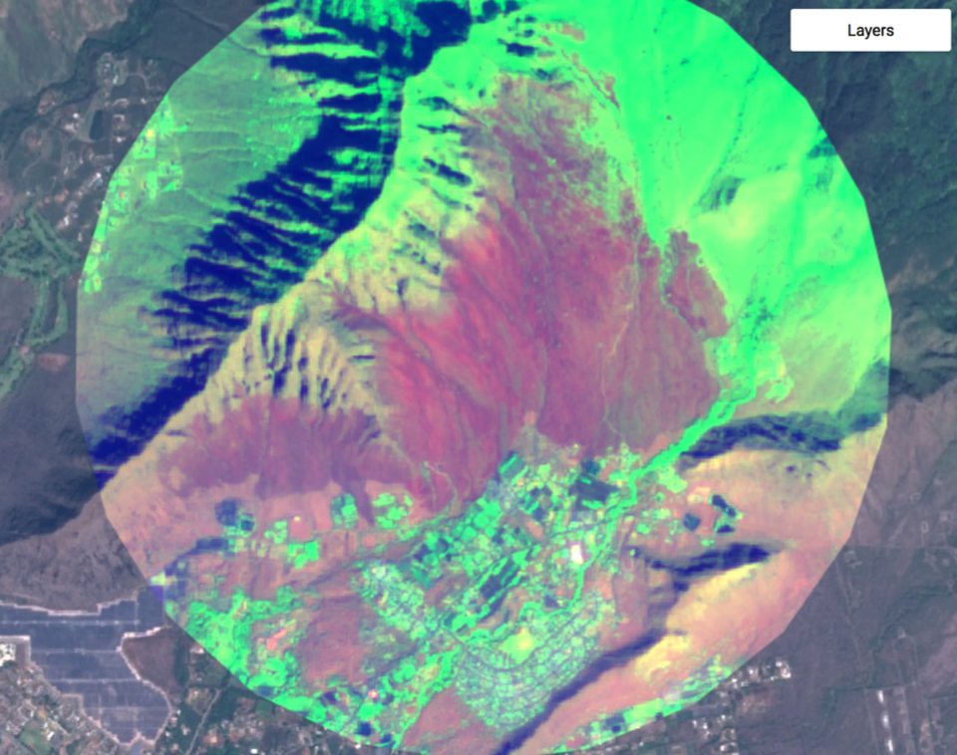
National Fire Incident
Reporting System
(thanks Mike Walker!)
2002-2012 Average:
1000 ignitions per yr
20,000 acres (+/- 5,000 acres) per yr
NFIRS Data
2016: ?? Fires (County records not compiled)
15,847 acres (DOFAW fires only)
2017: 524 Fires
7697 acres total
Waianae, Oahu 2016

Slide 10
2017: 92% of area burned by 15 fires (7,060 acres)
Haena Fire, Kauai – 50 acres(?)
Are we missing anything – other ‘significant’ fires?

Slide 11
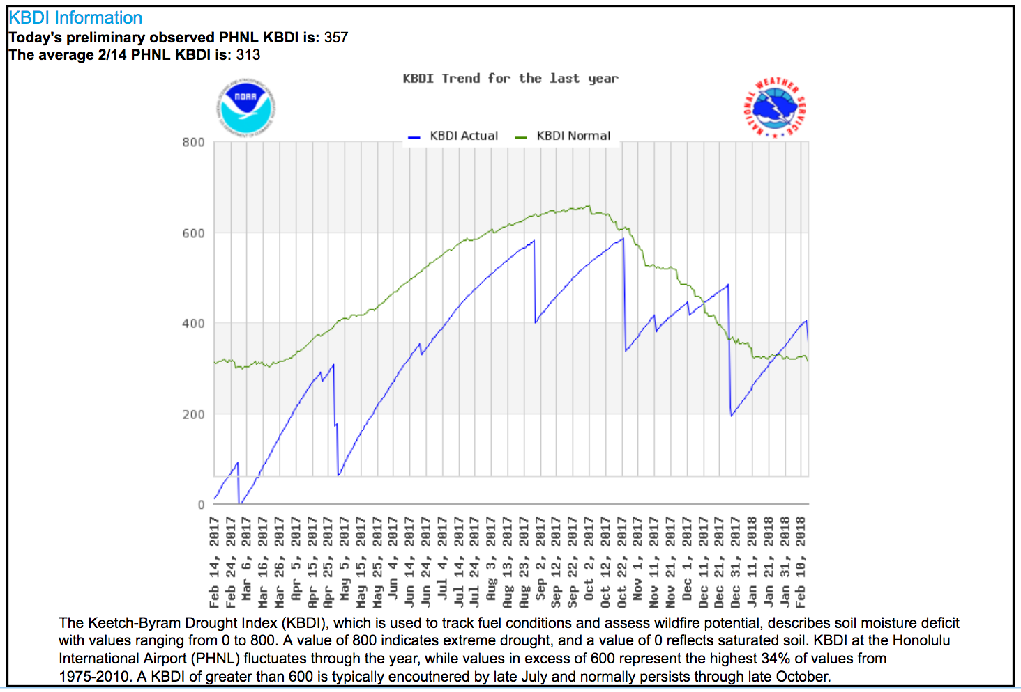
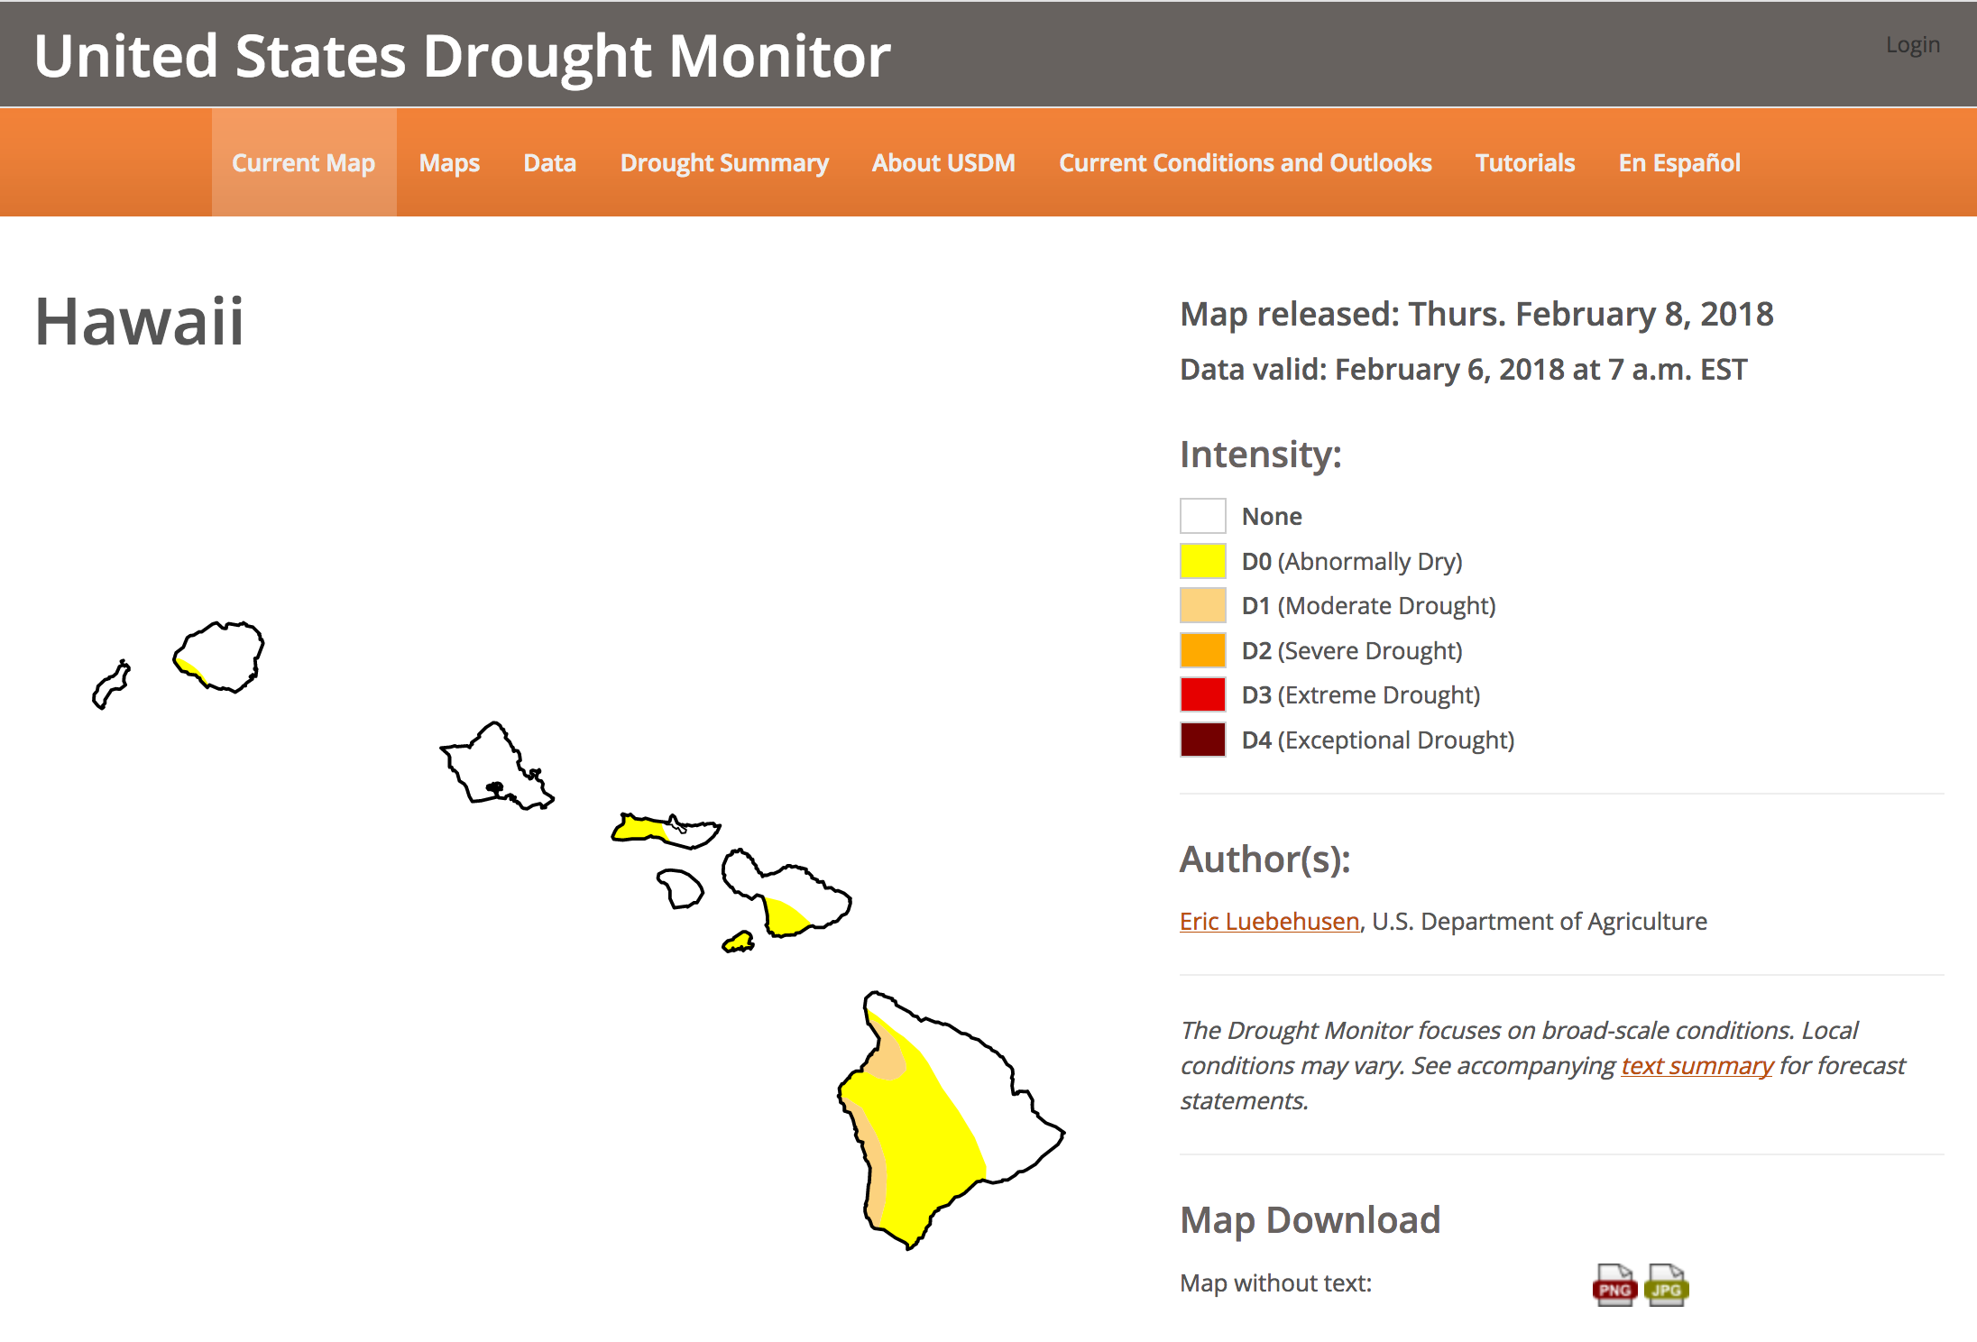
Drought
US Drought Monitor:
Weekly updates
National Weather Service:
Daily Keetch-Byram Drought Index

Slide 12
Drought
75% of all fires occur under
Category D0 or worse
US Drought Monitor:
Weekly updates

Slide 14
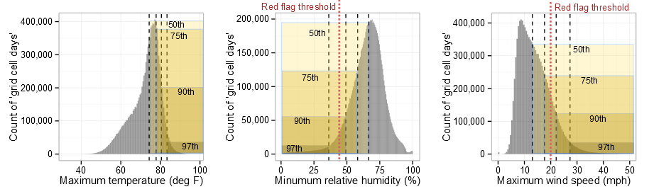
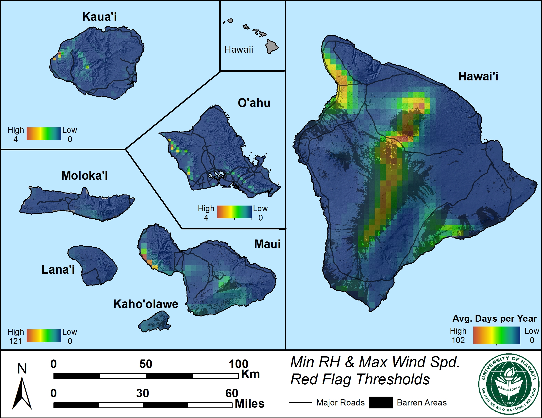
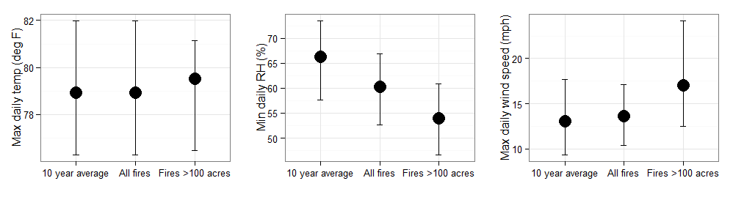
Relative Humidity and Wind Speed

Slide 15
Relative Humidity and Wind Speed
Date | Fire Location | Acres | MEAN MAX WIND | MAX WIND FIRE | MEAN MIN RH | MIN RH FIRE
2/1/17 | Pohakuloa | 764 | 4.0 | NA | 75 | 51
2/2/17 | Naalehu | 156 | 11.6 | 20 | 64 | 55
5/17/17 | Hawaii Kai | 65 | 8.9 | 24 | 60 | 53
5/19/17 | Waimea | 754 | 9.4 | 14 | 66 | 46
6/8/17 | Waialua | 377 | 8.1 | 17 | 65 | 54
7/7/17 | Waimea | 2195 | 14.8 | 36 | 76 | 43
7/27/17 | Kunia | 365 | 9.2 | 21 | 63 | 45
9/21/17 | Kahului | 175 | 8.1 | 30 | 60 | 37
9/22/17 | Kau (Waikapuna) | 1466 | 11.6 | NA | 62 | 76
9/25/17 | Poipu | 200 | 13.4 | 19 | 58 | 49
10/9/17 | C. Maui-3 fires | 437 | 9.8 | 19 | 61 | 43
10/21/17 | Pahala | 67 | 5.4 | 21 | 70 | 48
 |  |  | 10 | 22 | 64 | 49

Slide 16
Relative Humidity and Wind Speed
Date | Fire Location | Acres | MEAN MAX WIND | MAX WIND FIRE | MEAN MIN RH | MIN RH FIRE
2/1/17 | Pohakuloa | 764 | 4.0 | NA | 75 | 51
2/2/17 | Naalehu | 156 | 11.6 | 20 | 64 | 55
5/17/17 | Hawaii Kai | 65 | 8.9 | 24 | 60 | 53
5/19/17 | Waimea | 754 | 9.4 | 14 | 66 | 46
6/8/17 | Waialua | 377 | 8.1 | 17 | 65 | 54
7/7/17 | Waimea | 2195 | 14.8 | 36 | 76 | 43
7/27/17 | Kunia | 365 | 9.2 | 21 | 63 | 45
9/21/17 | Kahului | 175 | 8.1 | 30 | 60 | 37
9/22/17 | Kau (Waikapuna) | 1466 | 11.6 | NA | 62 | 76
9/25/17 | Poipu | 200 | 13.4 | 19 | 58 | 49
10/9/17 | C. Maui-3 fires | 437 | 9.8 | 19 | 61 | 43
10/21/17 | Pahala | 67 | 5.4 | 21 | 70 | 48
 |  |  | 10 | 22 | 64 | 49

Slide 17
Relative Humidity and Wind Speed
Date | Fire Location | Acres | MEAN MAX WIND | MAX WIND FIRE | MEAN MIN RH | MIN RH FIRE
2/1/17 | Pohakuloa | 764 | 4.0 | NA | 75 | 51
2/2/17 | Naalehu | 156 | 11.6 | 20 | 64 | 55
5/17/17 | Hawaii Kai | 65 | 8.9 | 24 | 60 | 53
5/19/17 | Waimea | 754 | 9.4 | 14 | 66 | 46
6/8/17 | Waialua | 377 | 8.1 | 17 | 65 | 54
7/7/17 | Waimea | 2195 | 14.8 | 36 | 76 | 43
7/27/17 | Kunia | 365 | 9.2 | 21 | 63 | 45
9/21/17 | Kahului | 175 | 8.1 | 30 | 60 | 37
9/22/17 | Kau (Waikapuna) | 1466 | 11.6 | NA | 62 | 76
9/25/17 | Poipu | 200 | 13.4 | 19 | 58 | 49
10/9/17 | C. Maui-3 fires | 437 | 9.8 | 19 | 61 | 43
10/21/17 | Pahala | 67 | 5.4 | 21 | 70 | 48
 |  |  | 10 | 22 | 64 | 49

Slide 18
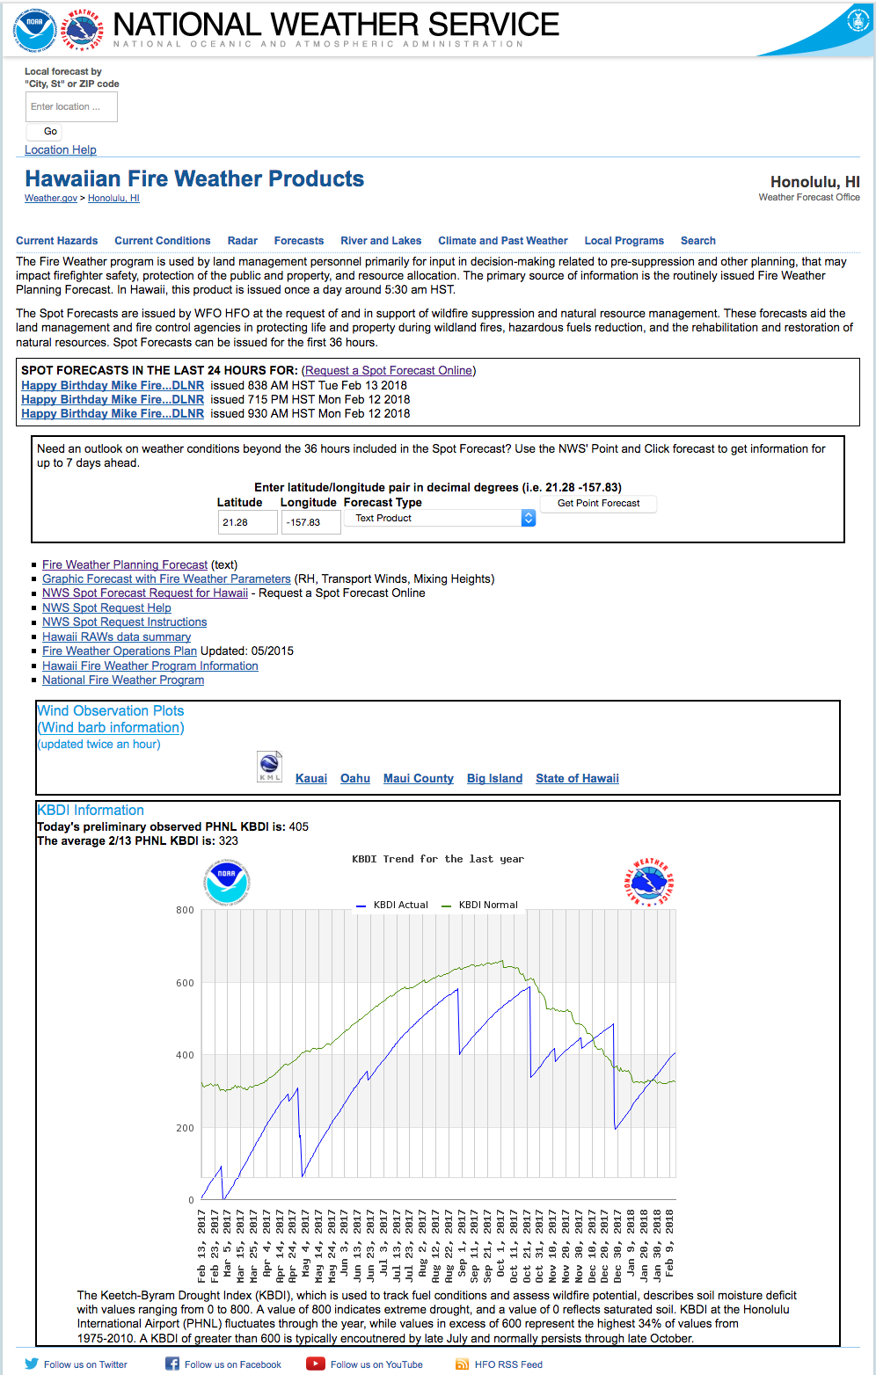
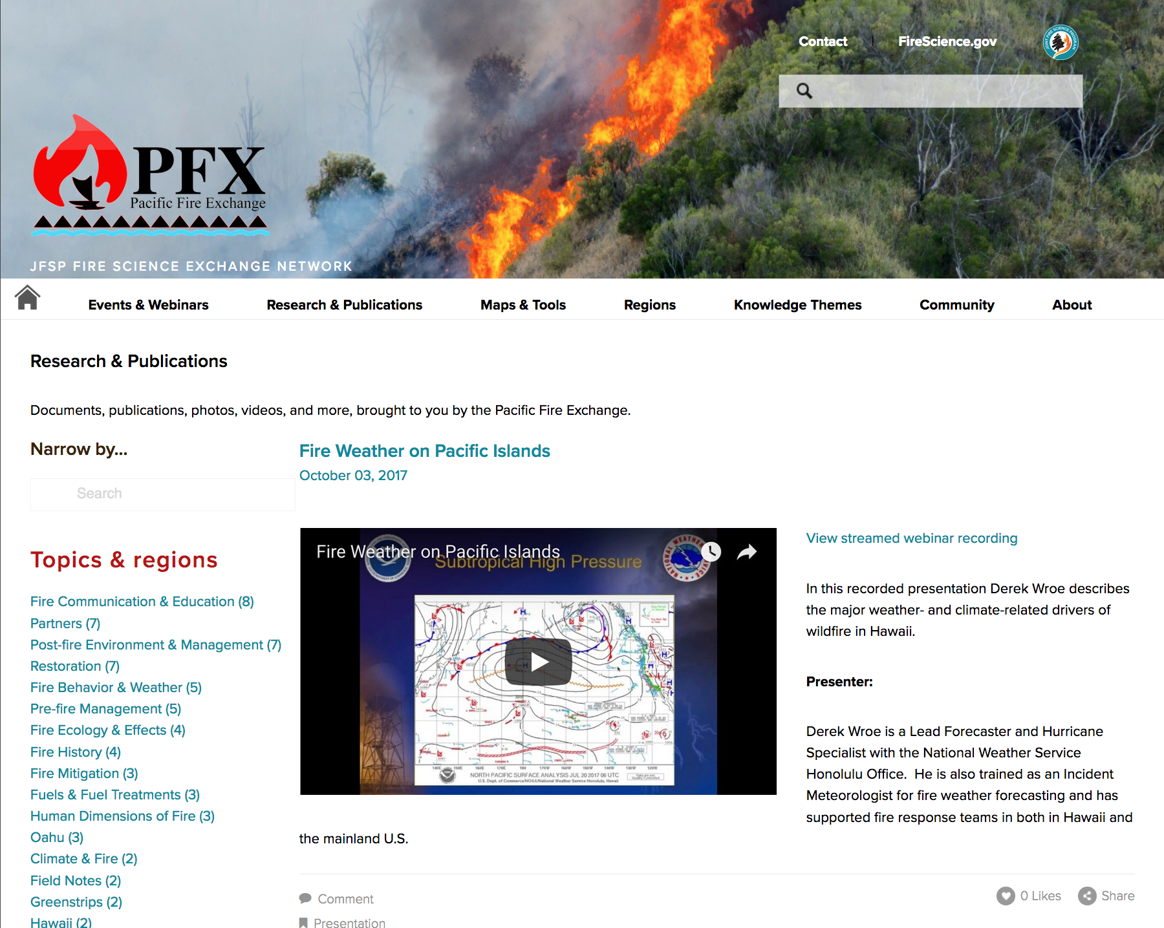
Fire Weather

Slide 19
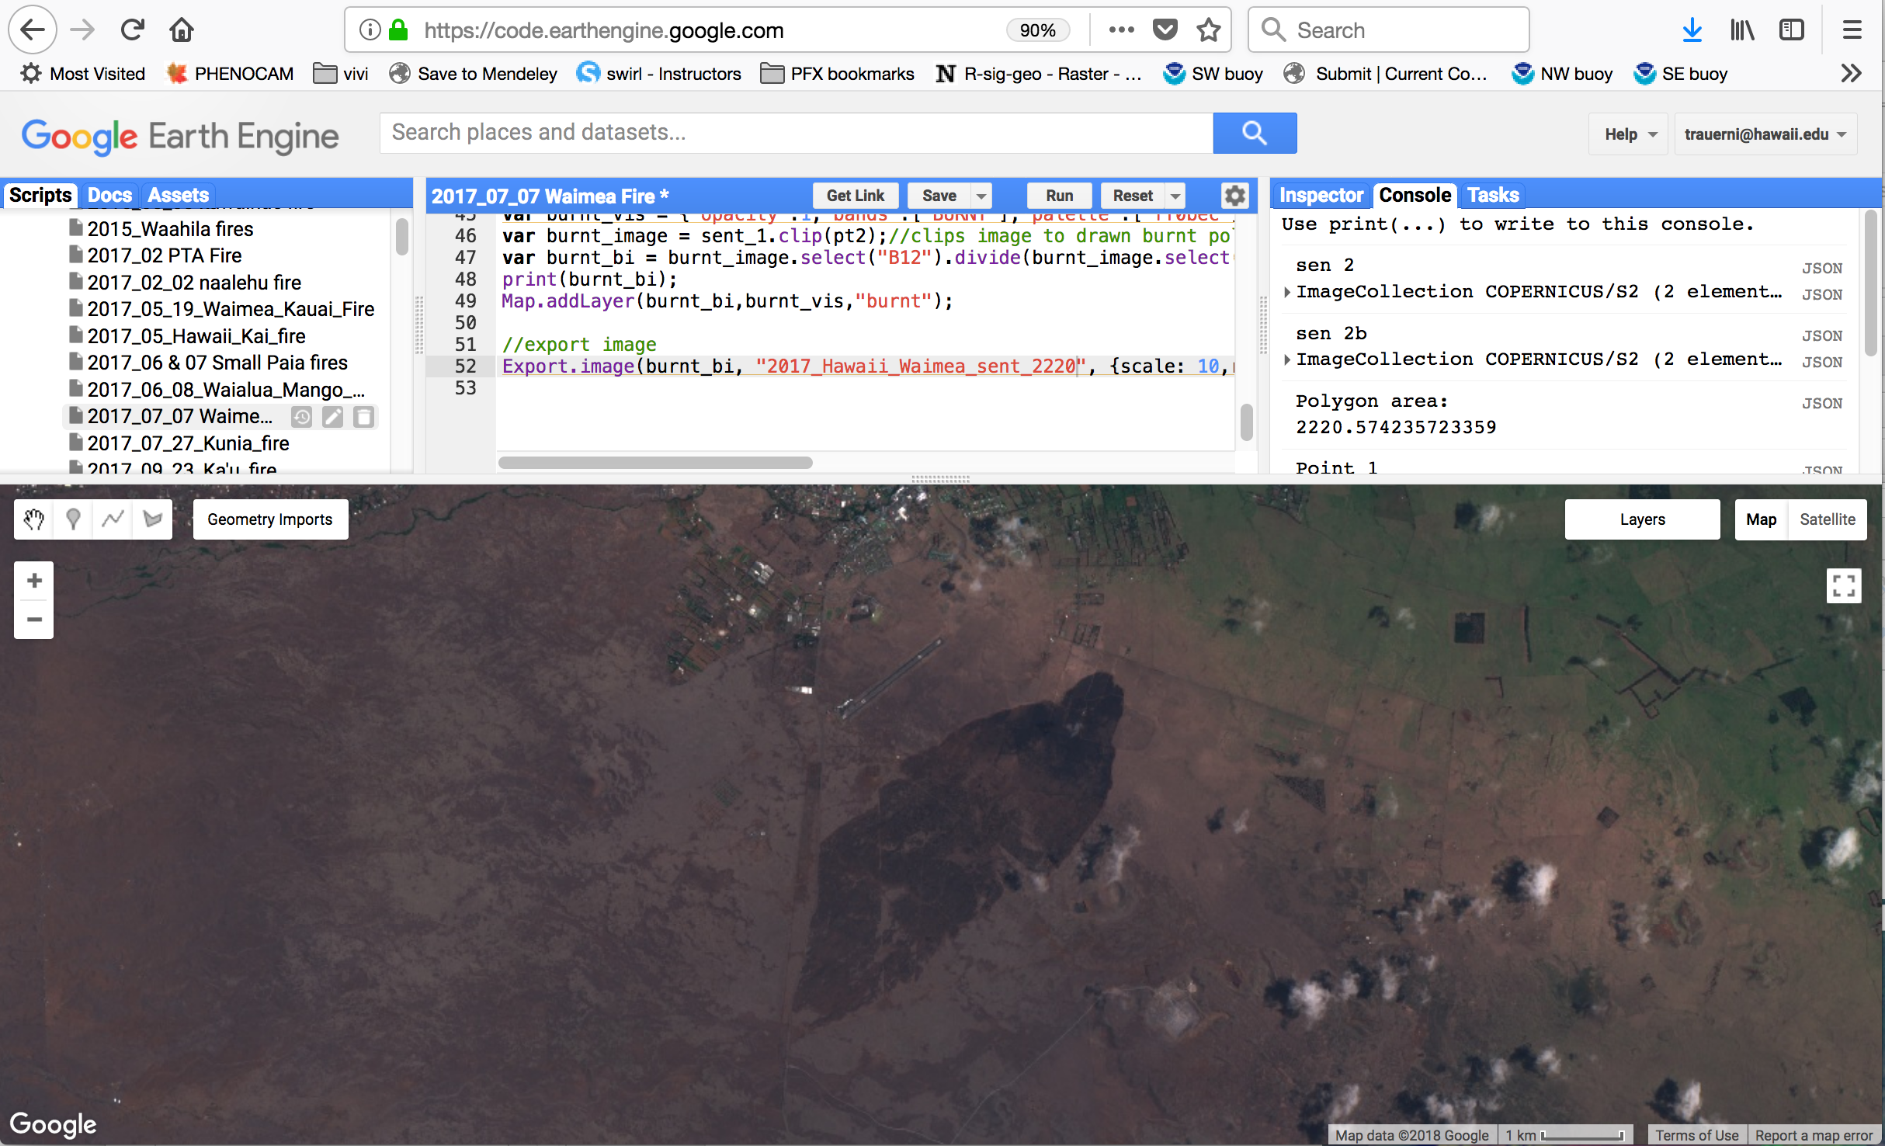
Fire mapping workflow
Geographical Information Systems:
Google Earth Engine:
  Acquire sattelite image
  Map perimeter & export
Align with Land Cover Maps
  Automated code in R
  (Hawaii Gap Analysis)

Slide 20
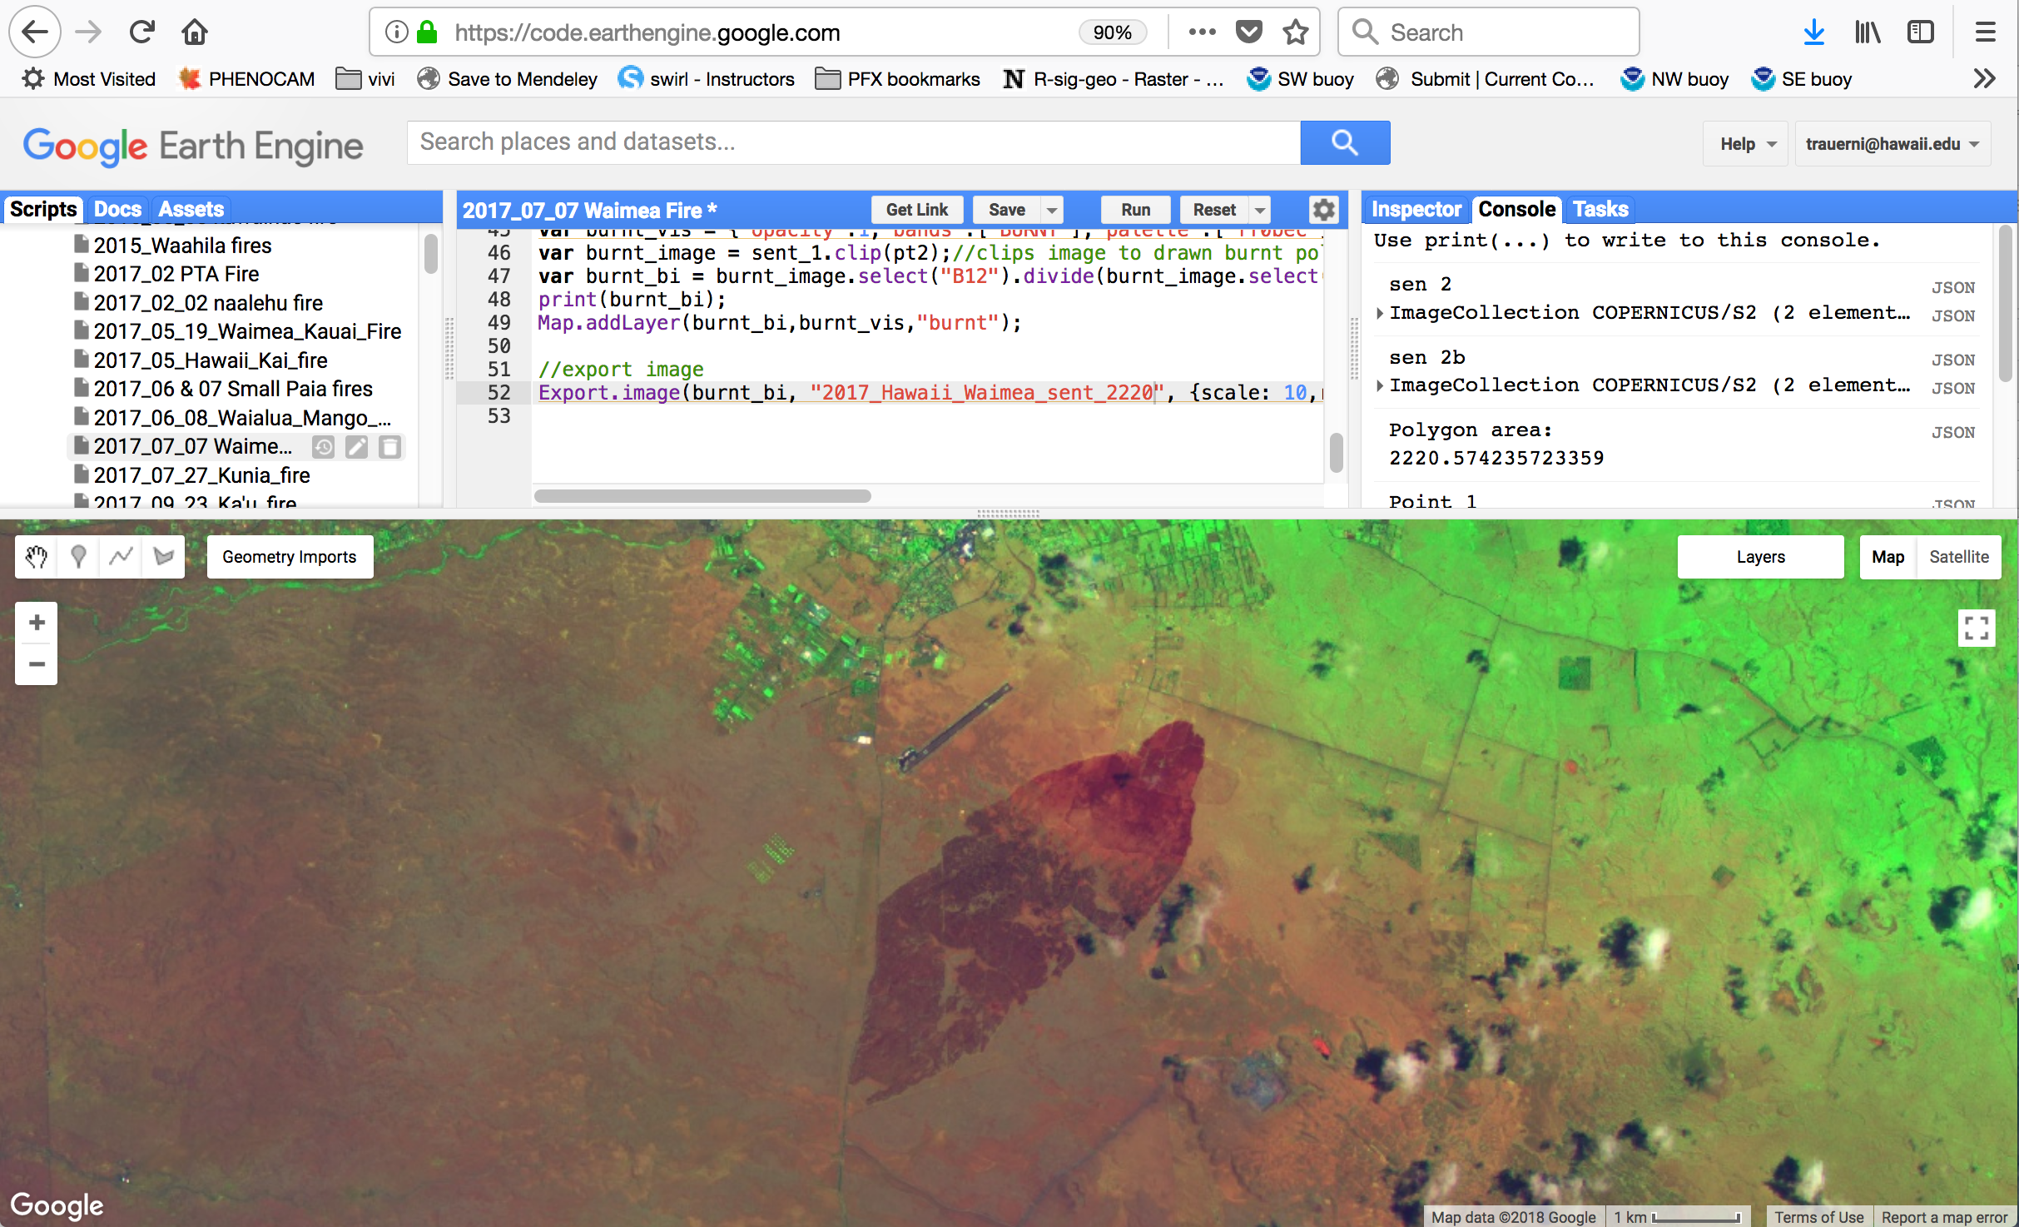
Fire mapping workflow
Geographical Information Systems:
Google Earth Engine:
  Acquire sattelite image
  Map perimeter & export
Align with Land Cover Maps
  Automated code in R
  (Hawaii Gap Analysis)

Slide 21
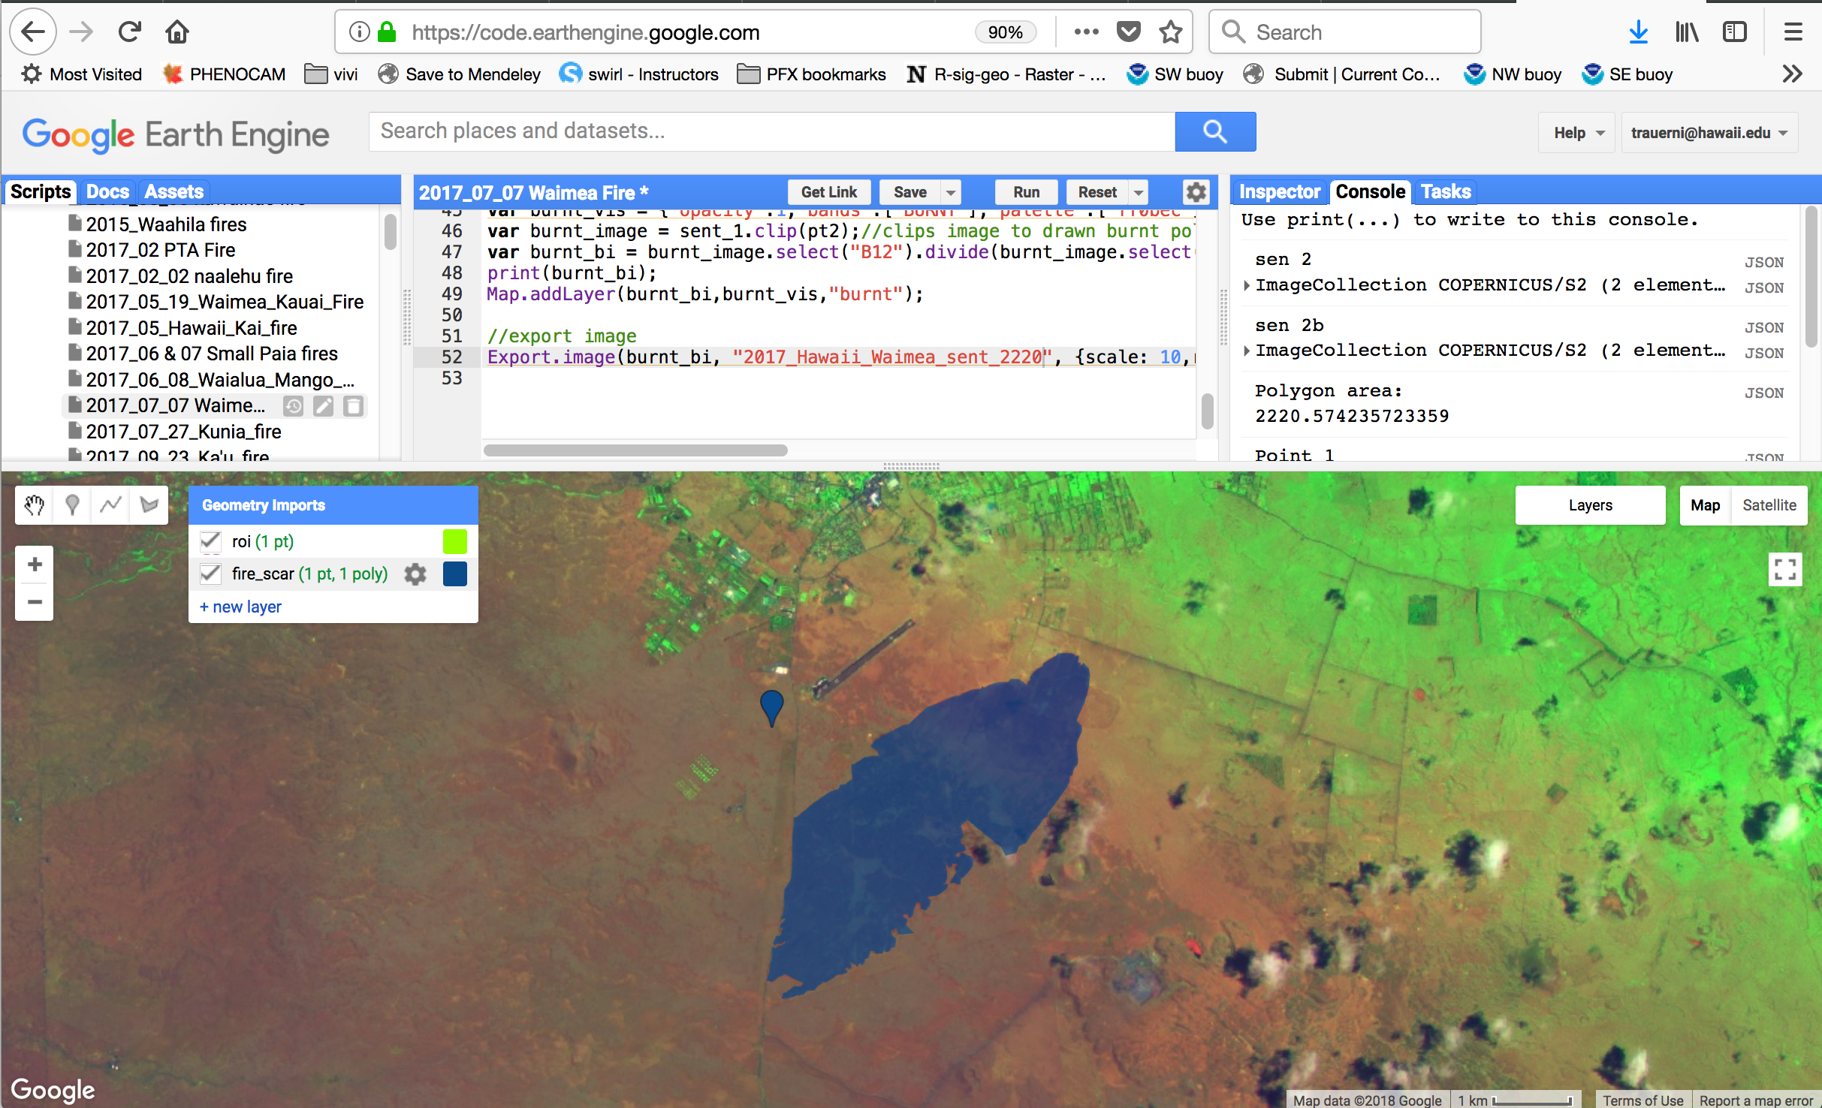
Fire mapping workflow
Geographical Information Systems:
Google Earth Engine:
  Acquire sattelite image
  Map perimeter & export
Align with Land Cover Maps
  Automated code in R
  (Hawaii Gap Analysis)

Slide 22
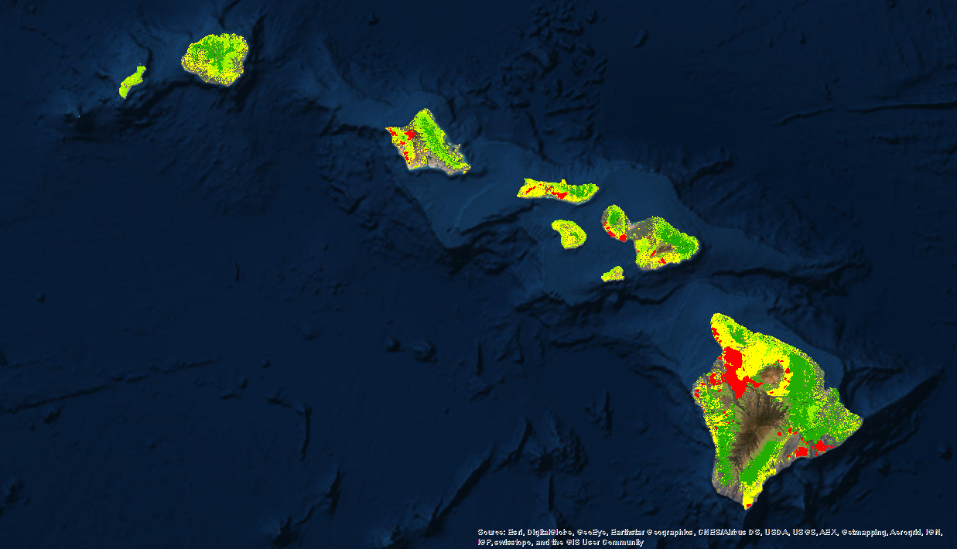
Fire mapping workflow
Geographical Information Systems:
Google Earth Engine:
  Acquire sattelite image
  Map perimeter & export
Align with Land Cover Maps
  Automated code in R
  (Hawaii Gap Analysis)
Percent Area Burned per Veg Type
(2002-2011):
14% Forest
31% Shrubland
55% Grassland

Slide 23
Land Cover Burned

Slide 24
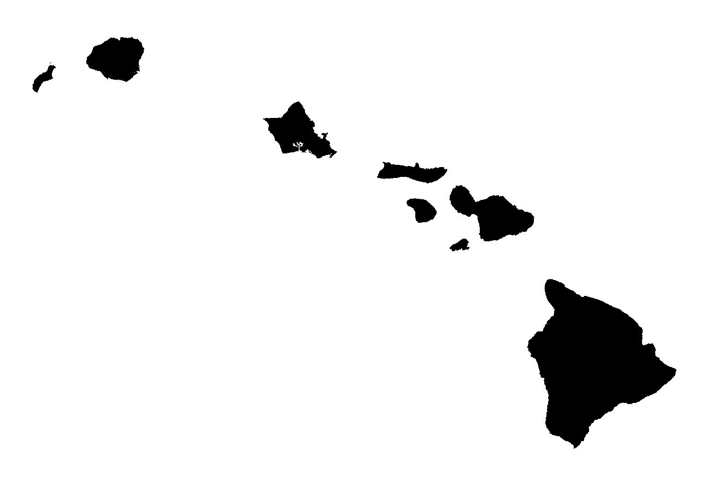
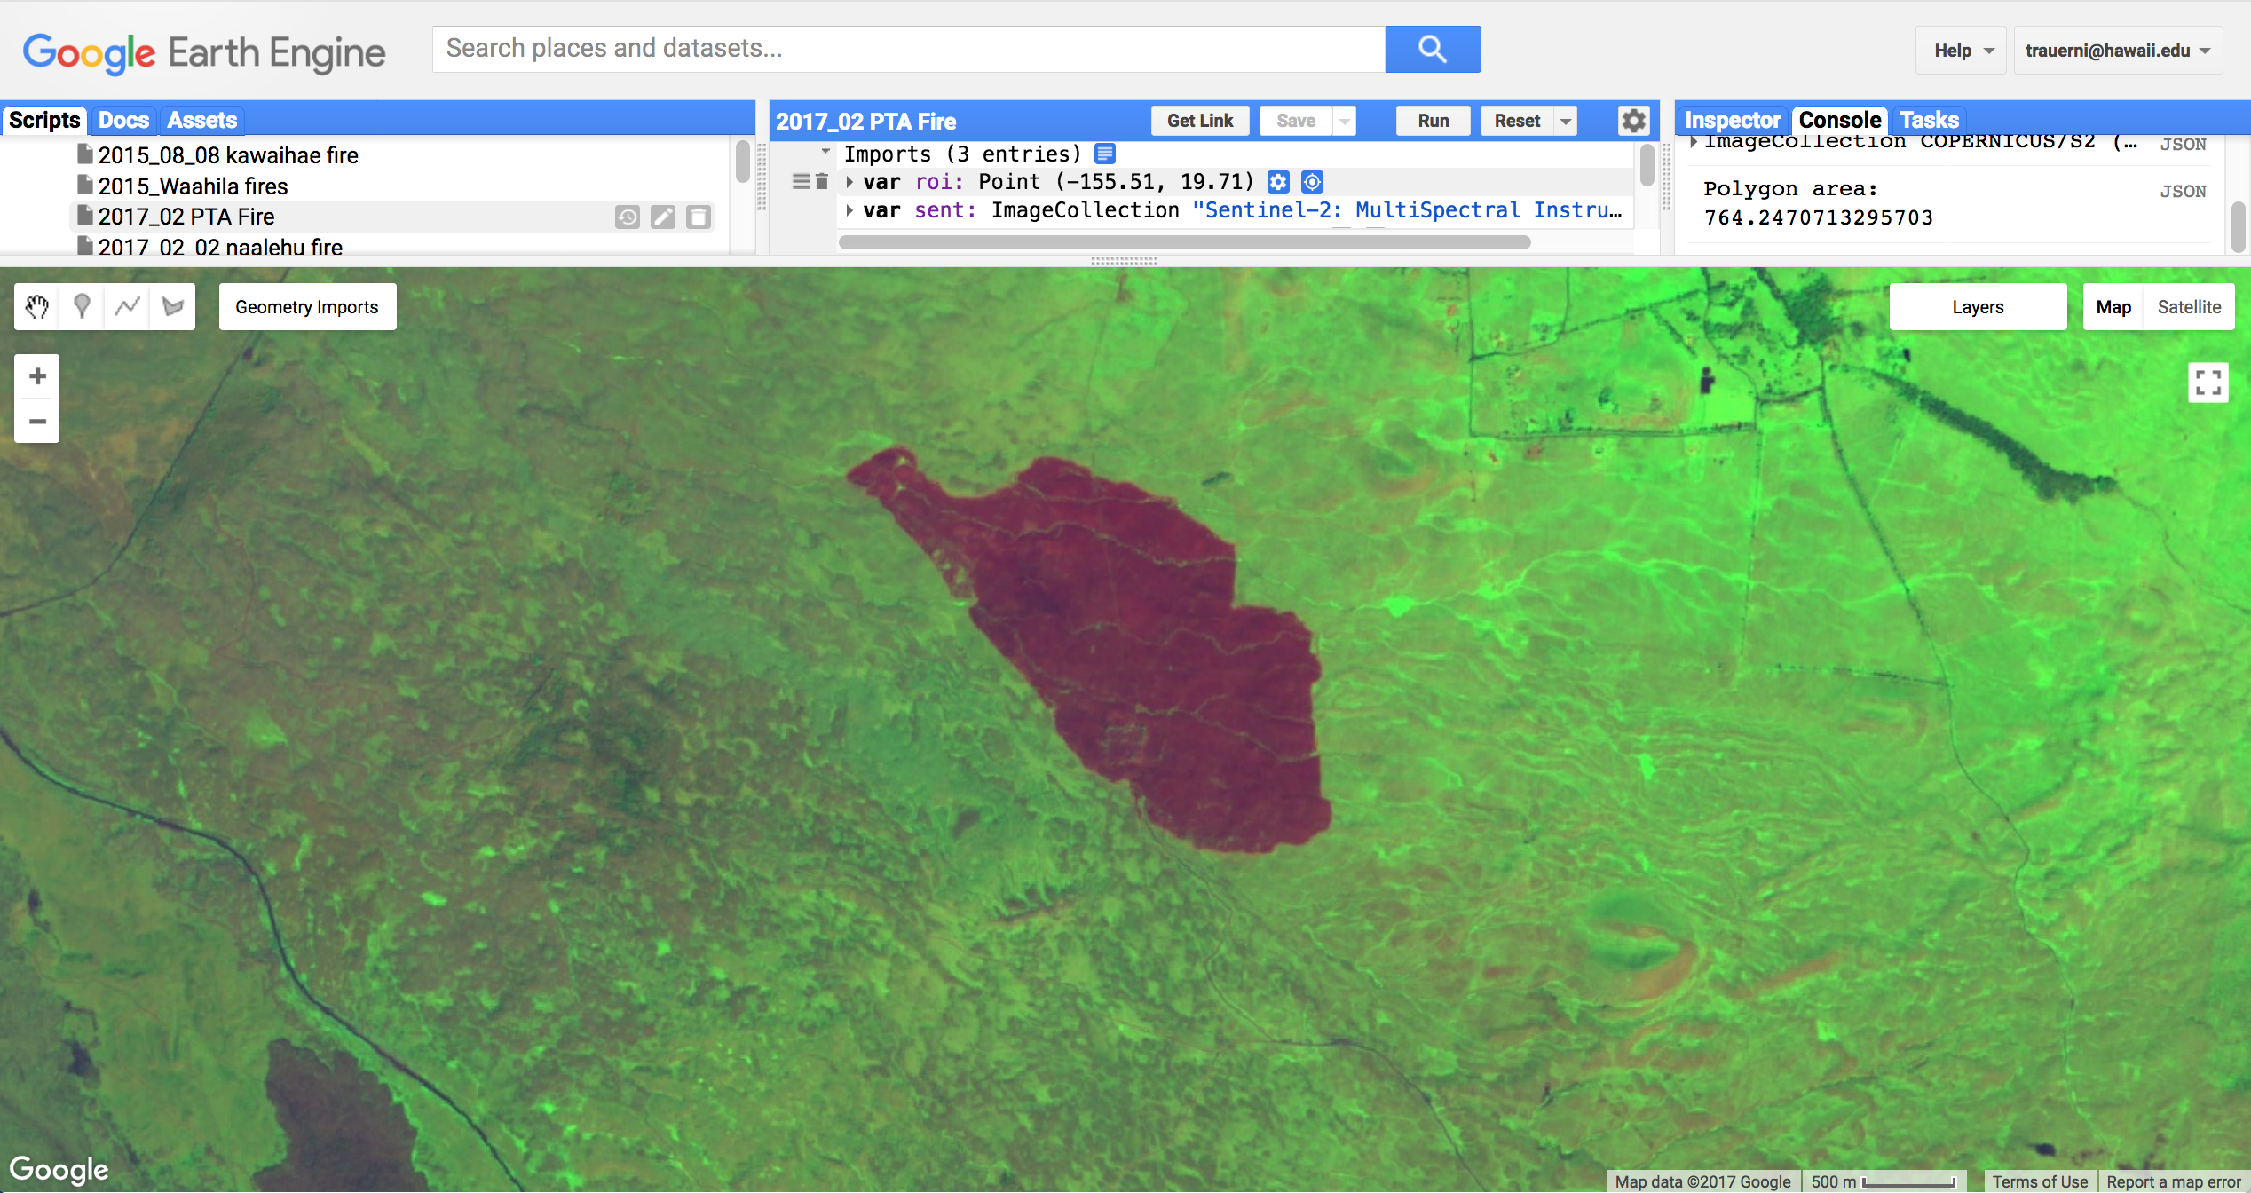
Large Fires
2/2/17 Pohakuloa 764 acres
5/19/17 Waimea Kauai 754 acres
7/7/17 Waimea Hawaii 2195 acres
9/22/17 Waikapua (Ka’u) 1466 acres
Land Cover | Acres burned
Alien Forest | 11
Alien Grassland | 764
Native Shrubland | 2
Other | 6

Slide 25
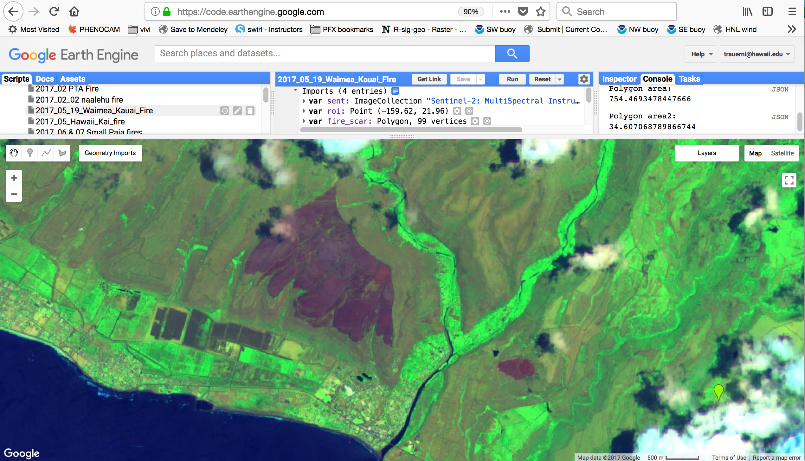
Large Fires
2/2/17 Pohakuloa 764 acres
5/19/17 Waimea Kauai 754 acres
7/7/17 Waimea Hawaii 2195 acres
9/22/17 Waikapua (Ka’u) 1466 acres
Land cover | Acres burned
Alien Grassland | 1
Alien Forest | 5
Other | 350
Alien Shrubland | 417
Other | 38

Slide 26
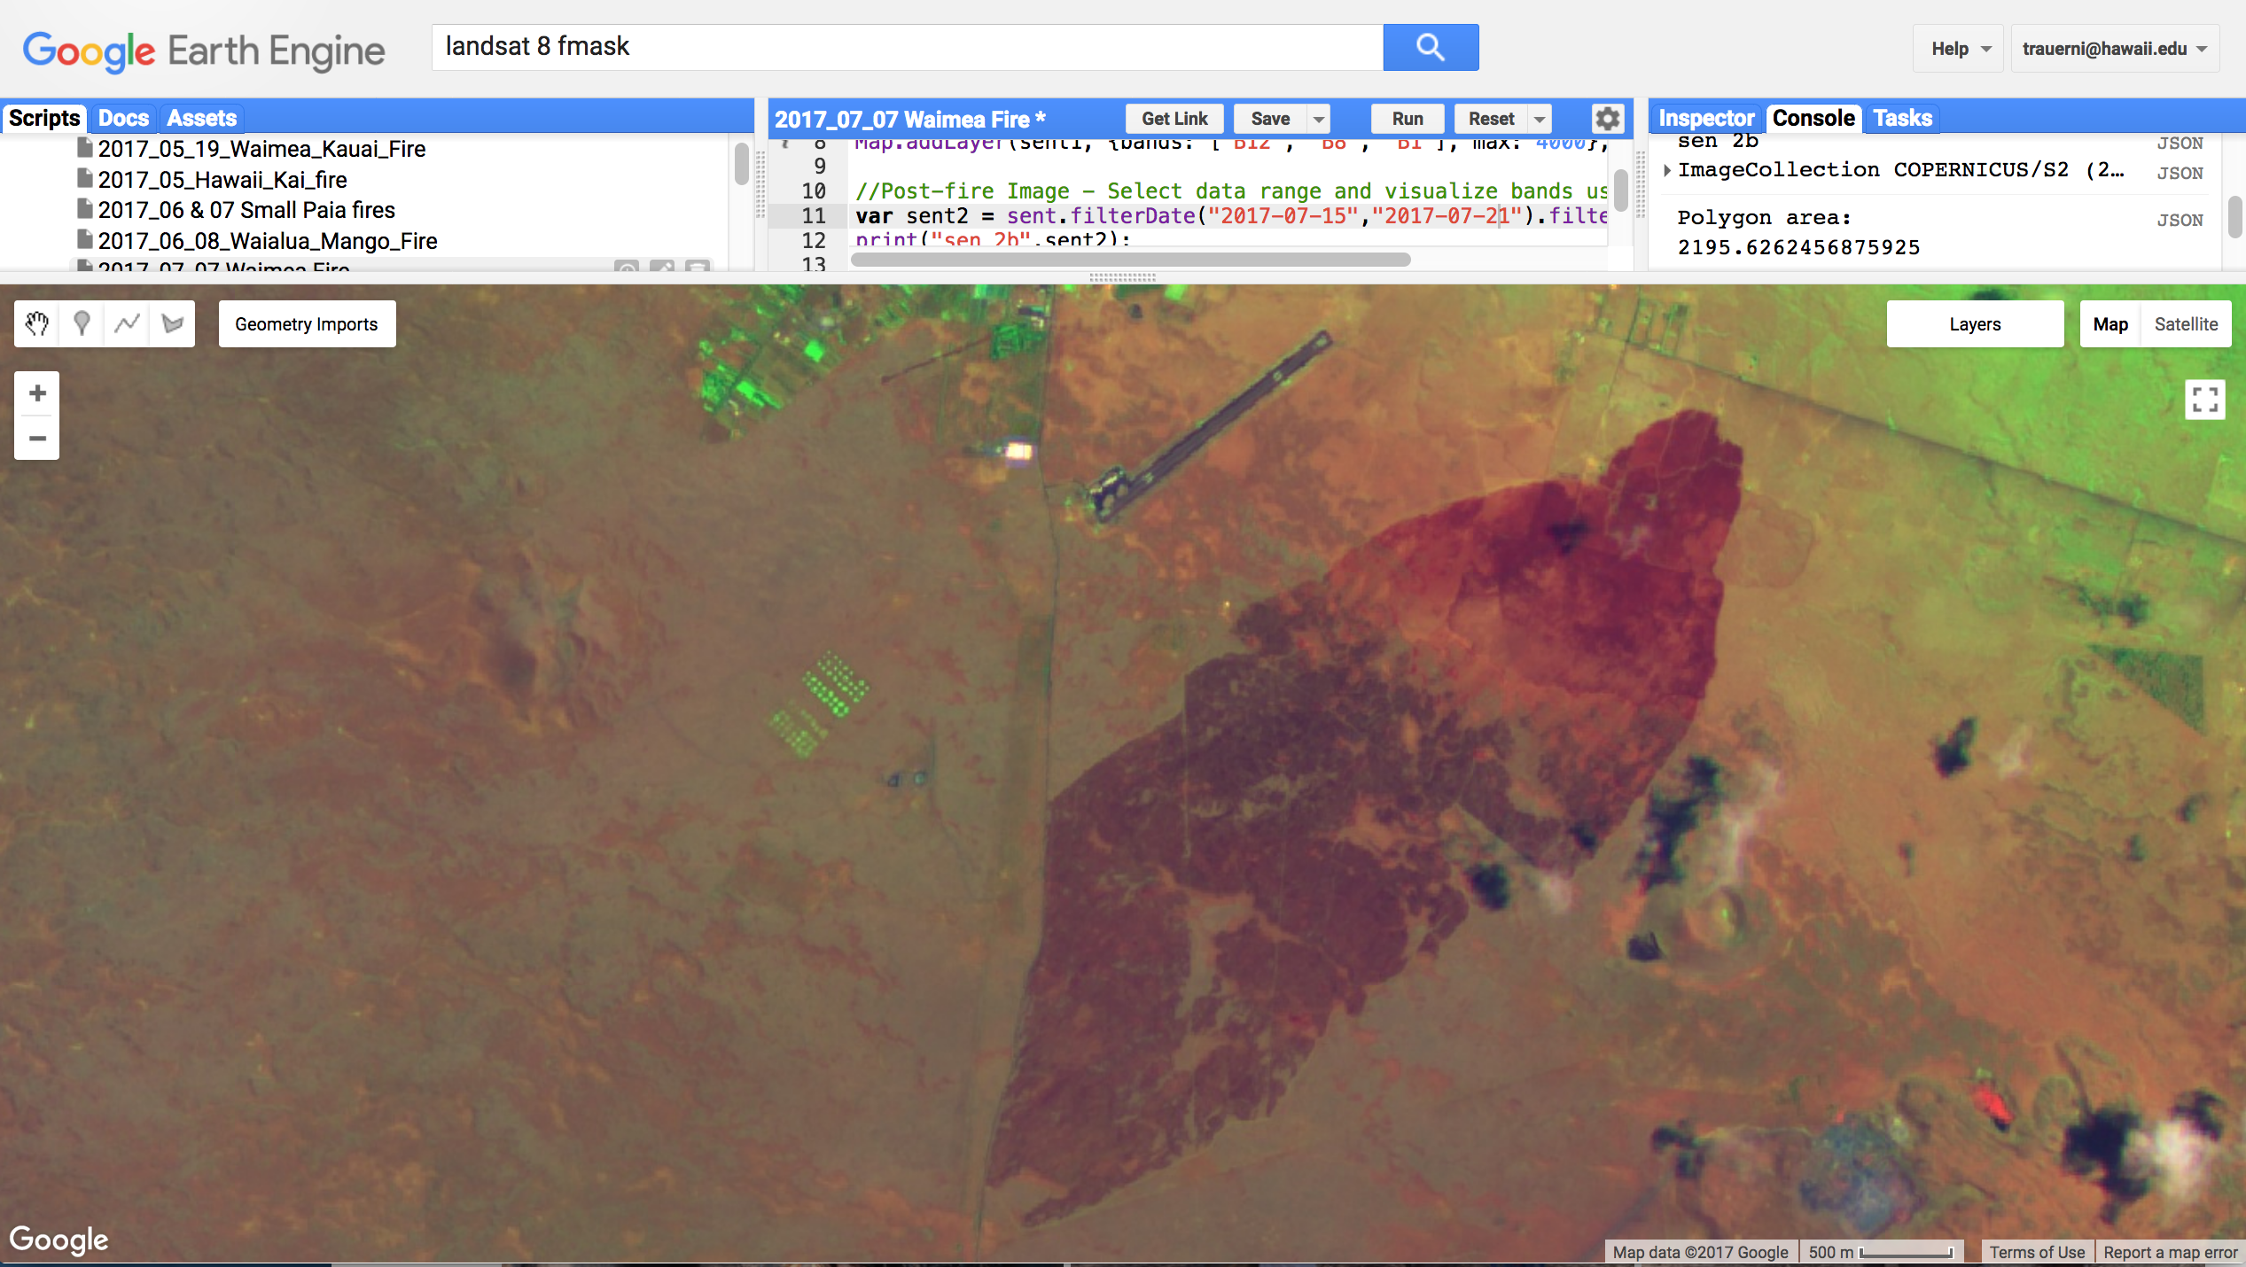
Large Fires
2/2/17 Pohakuloa 764 acres
5/19/17 Waimea Kauai 754 acres
7/7/17 Waimea Hawaii 2195 acres
9/22/17 Waikapua (Ka’u) 1466 acres
Land cover | Acres burned
Native Shrubland | 19
Other | 33
Alien Grassland | 2186

Slide 27
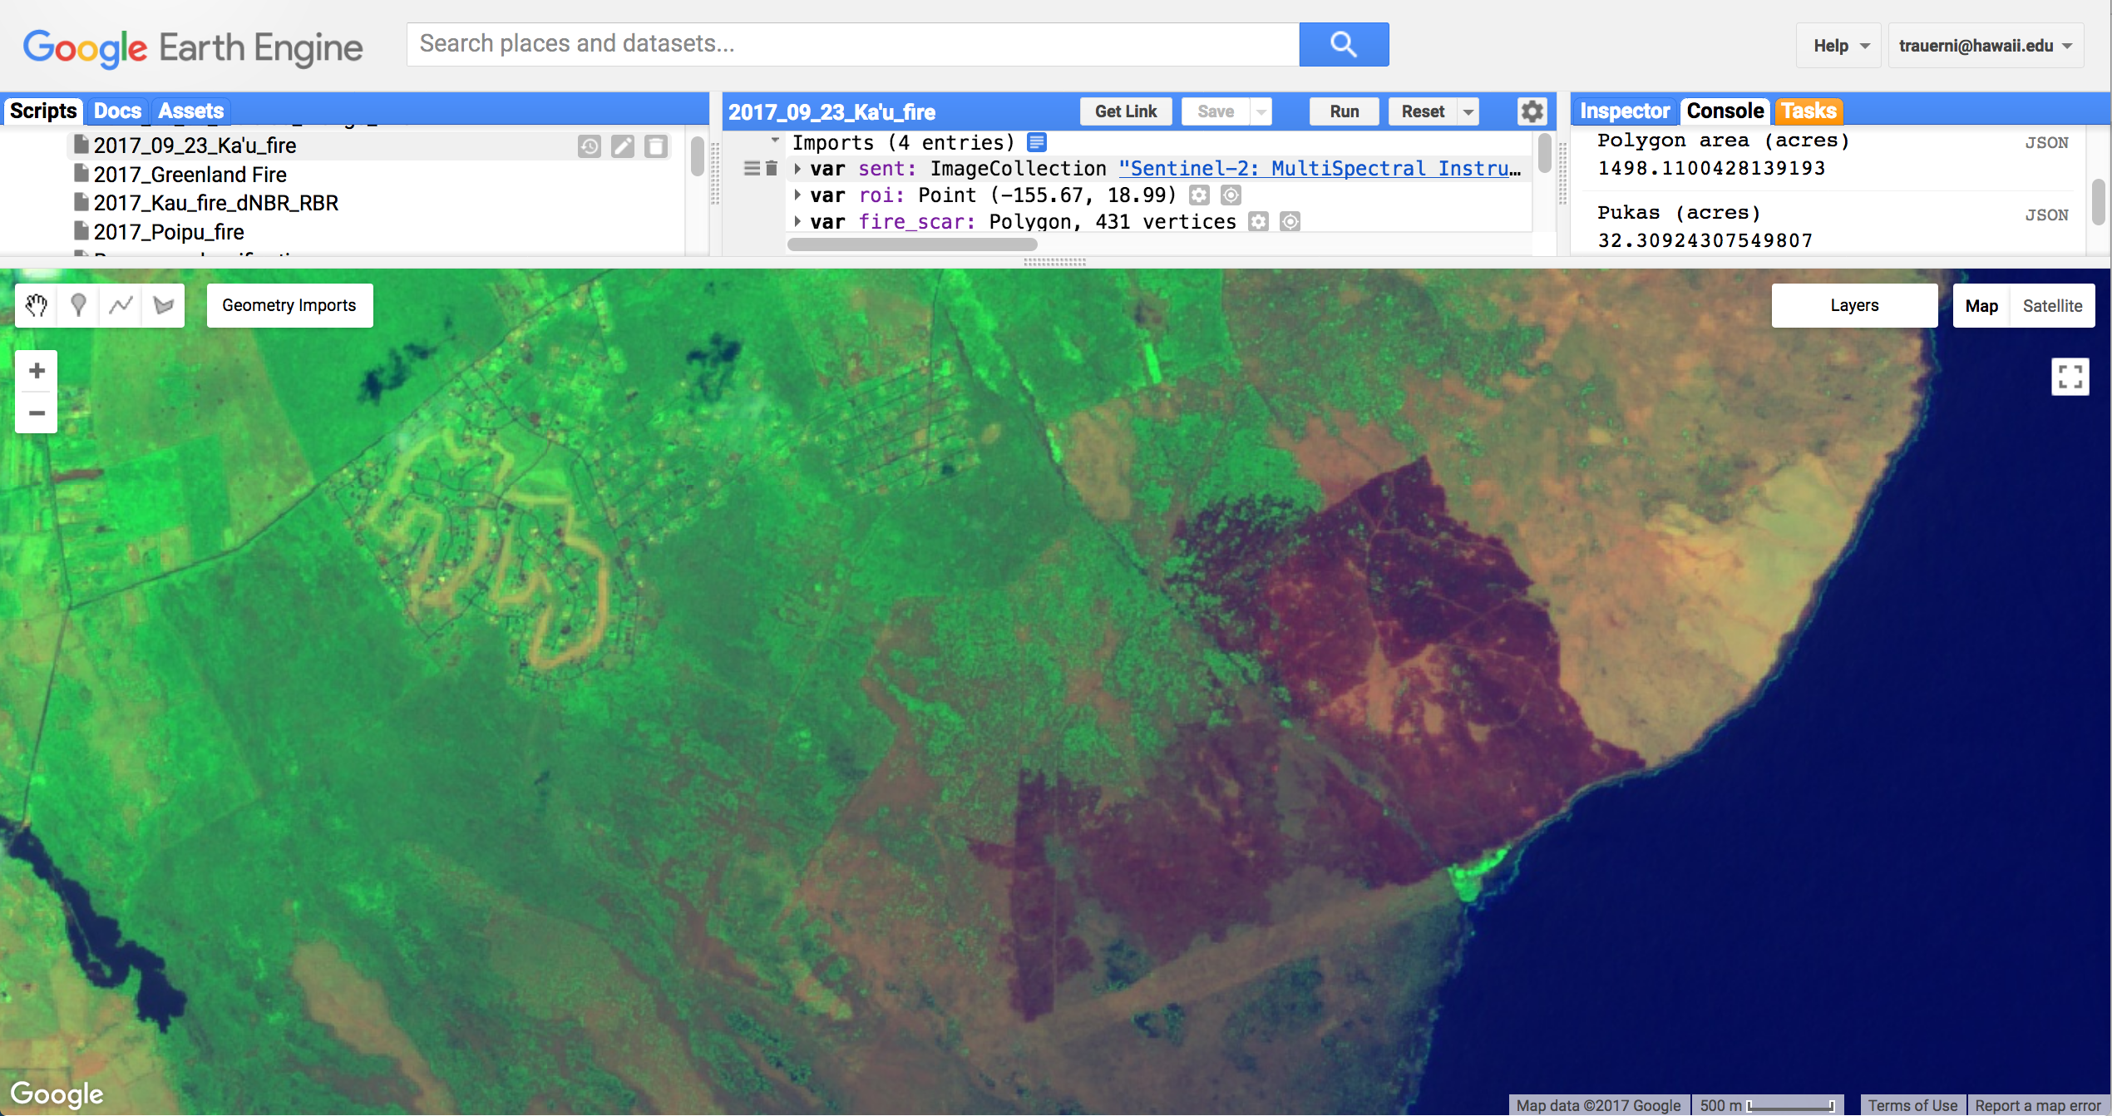
Large Fires
2/2/17 Pohakuloa 764 acres
5/19/17 Waimea Kauai 754 acres
7/7/17 Waimea Hawaii 2195 acres
9/22/17 Waikapua (Ka’u) 1466 acres
Land cover | Acres burned
Other | 5
Alien Forest | 192
Alien Shrubland | 629
Alien Grassland | 724

Slide 28
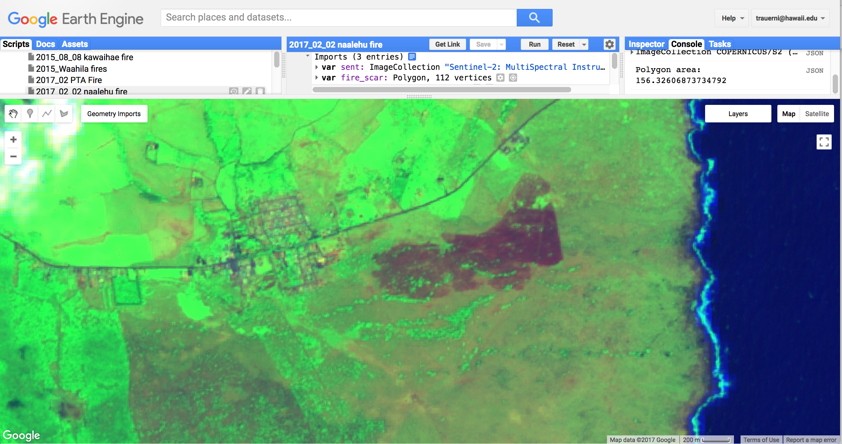
WUI Fires
2/2/17 Naalehu 156 acres
2/4/17 Sandys/Kokohead 38 acres
5/17/17 Hawaii Kai (Kamilonui) 65 acres
7/7/17 Kahului Fire 175 acres
7/27/17 Kunia Fire 365 acres
10/21/17 Pahala Fire 67 acres
Land cover | Acres burned
Alien Shrubland | 13
Alien Forest | 16
Alien Grassland | 140

Slide 29
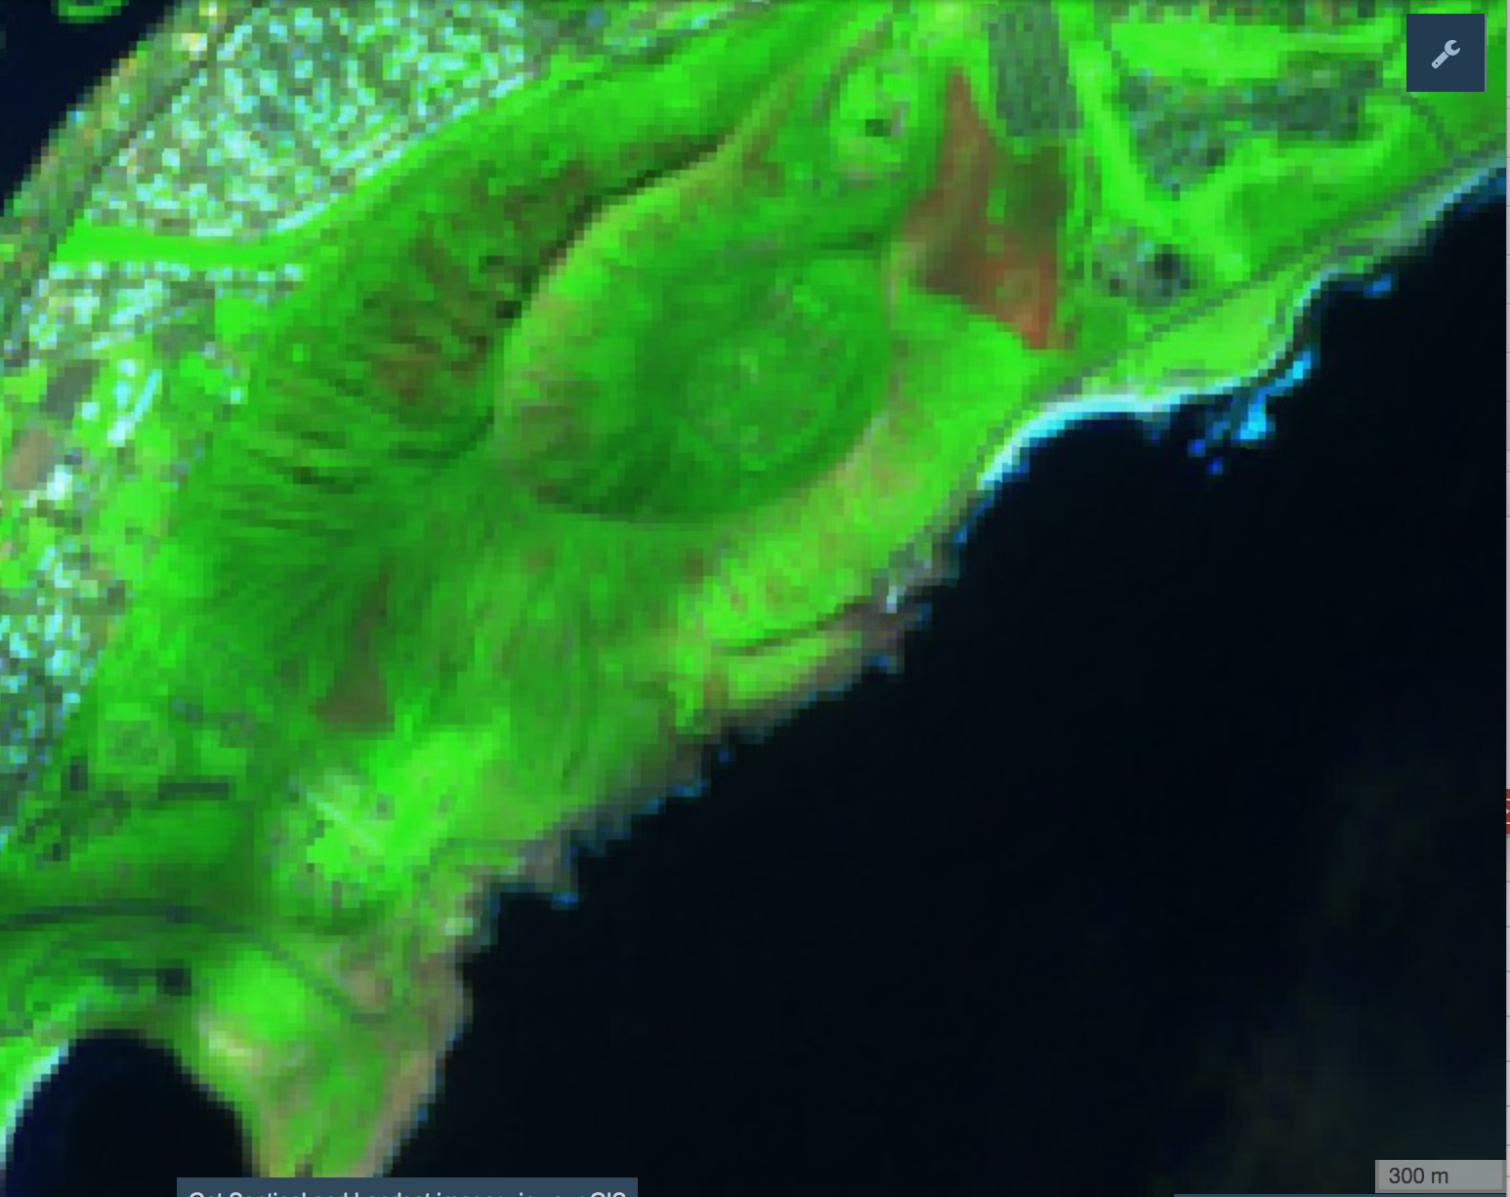
WUI Fires
2/2/17 Naalehu 156 acres
2/4/17 Sandys/Kokohead 38 acres
5/17/17 Hawaii Kai (Kamilonui) 65 acres
7/7/17 Kahului Fire 175 acres
7/27/17 Kunia Fire 365 acres
10/21/17 Pahala Fire 67 acres
Land cover | Acres burned
Alien Forest | 11
Alien Shrubland | 14
Alien Grassland | 18
Other | 1

Slide 30
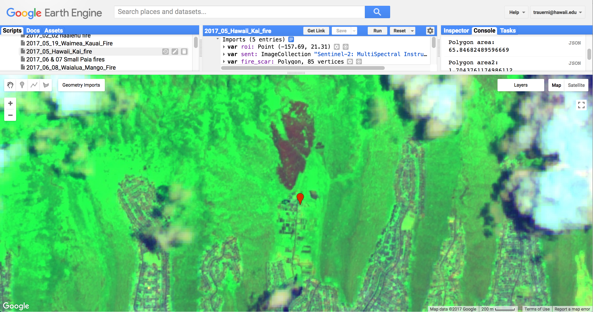
WUI Fires
2/2/17 Naalehu 156 acres
2/4/17 Sandys/Kokohead 38 acres
5/17/17 Hawaii Kai (Kamilonui) 65 acres
7/7/17 Kahului Fire 175 acres
7/27/17 Kunia Fire 365 acres
10/21/17 Pahala Fire 67 acres
Land cover | Acres burned
Alien Forest | 7
Alien Shrubland | 9
Alien Grassland | 56

Slide 31
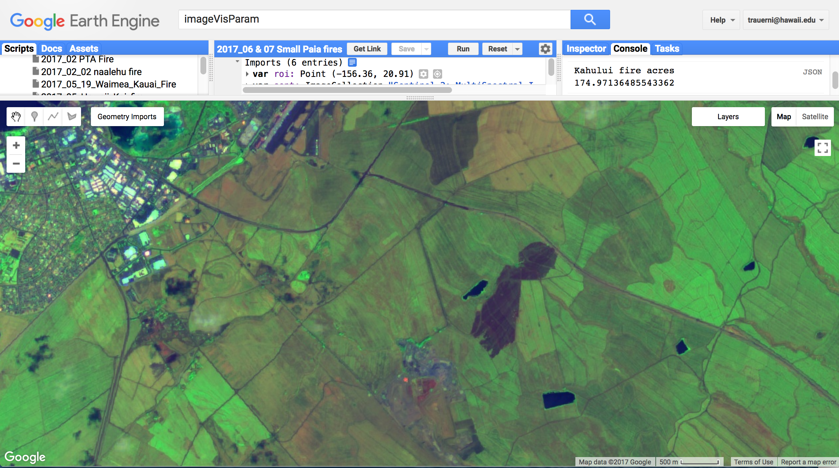
WUI Fires
2/2/17 Naalehu 156 acres
2/4/17 Sandys/Kokohead 38 acres
5/17/17 Hawaii Kai (Kamilonui) 65 acres
7/7/17 Kahului Fire 175 acres
7/27/17 Kunia Fire 365 acres
10/21/17 Pahala Fire 67 acres
Land cover | Acres burned
Alien Grassland | 1
Cultivated lands | 184

Slide 32
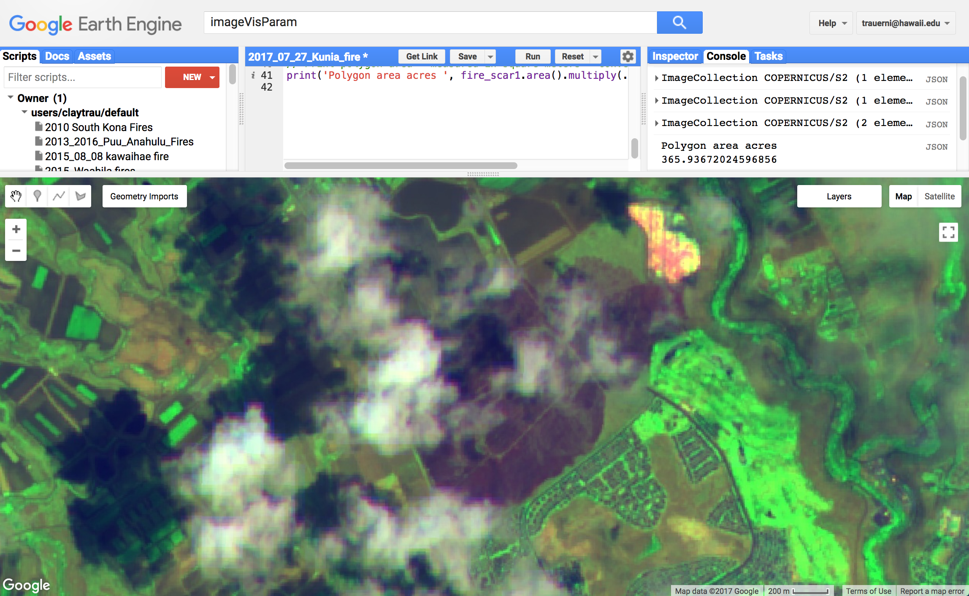
WUI Fires
2/2/17 Naalehu 156 acres
2/4/17 Sandys/Kokohead 38 acres
5/17/17 Hawaii Kai (Kamilonui) 65 acres
7/7/17 Kahului Fire 175 acres
7/27/17 Kunia Fire 365 acres
10/21/17 Pahala Fire 67 acres
Land cover | Acres burned
Alien Forest | 3
Other | 66
Alien Grassland | 125
Alien Shrubland | 181

Slide 33
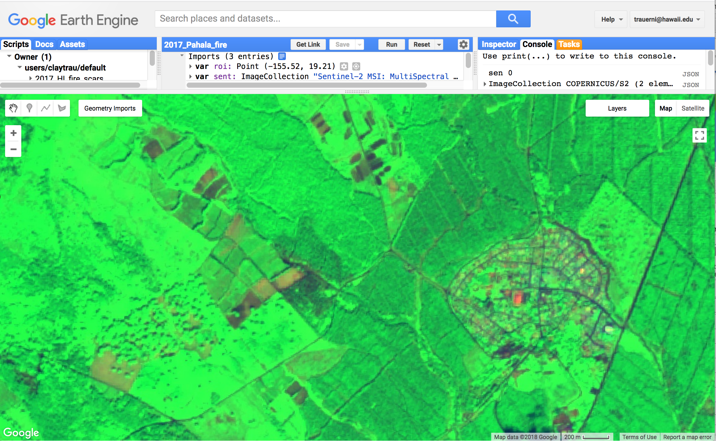
WUI Fires
2/2/17 Naalehu 156 acres
2/4/17 Sandys/Kokohead 38 acres
5/17/17 Hawaii Kai (Kamilonui) 65 acres
7/7/17 Kahului Fire 175 acres
7/27/17 Kunia Fire 365 acres
10/21/17 Pahala Fire 67 acres
Land cover | Acres burned
Alien Shrubland | 1
Alien Grassland | 2
Other | 10
Alien Forest | 62

Slide 34
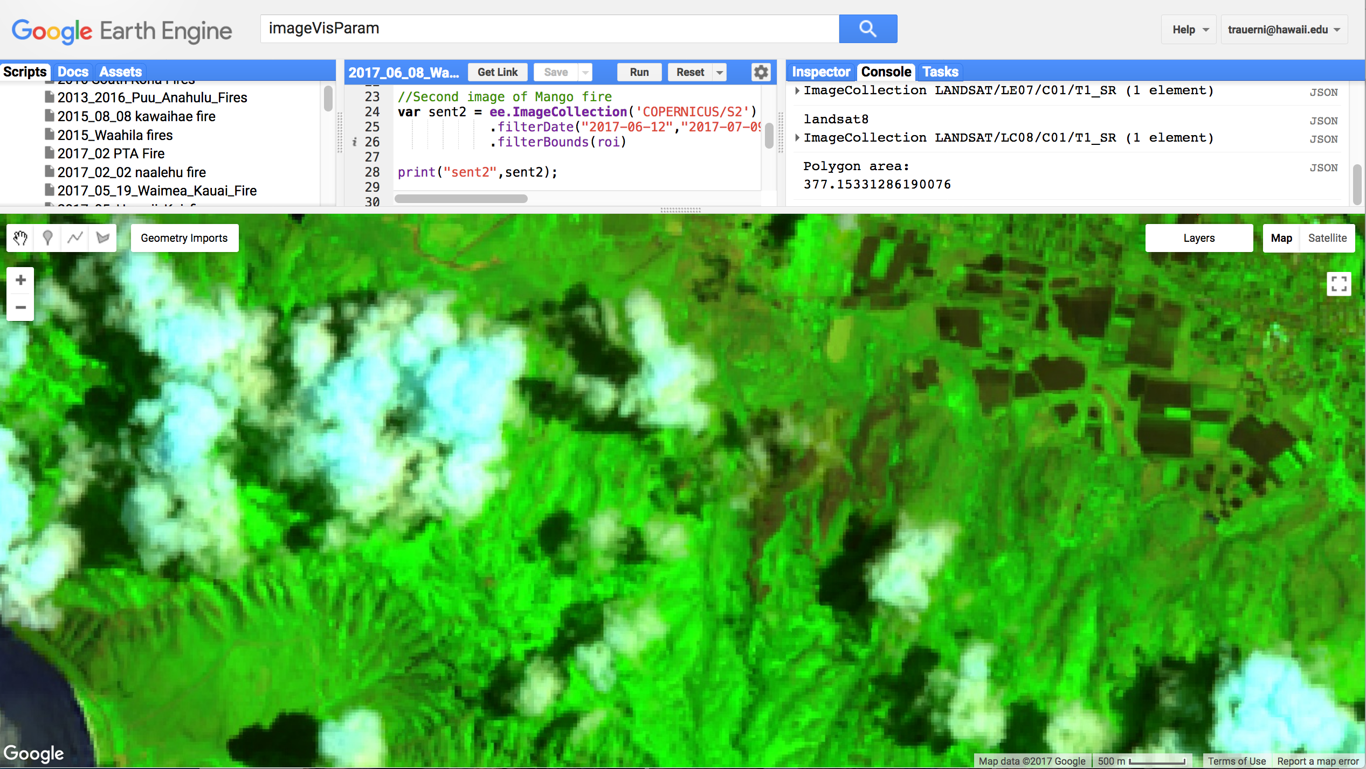
WUI, Ag & Forest
7/8/17 Waialua Mango Fire 377 acres
9/26/17 Poipu Fire 200 acres
10/9/17 Pulehu 1 (Central Maui) 107 acres
10/9/17 Pulehu 2 (Central Maui) 160 acres
10/9/17 Pulehu 3 (Central Maui) 170 acres
Land cover | Acres burned
Other | 21
Alien Grassland | 58
Alien Forest | 93
Alien Shrubland | 251

Slide 35
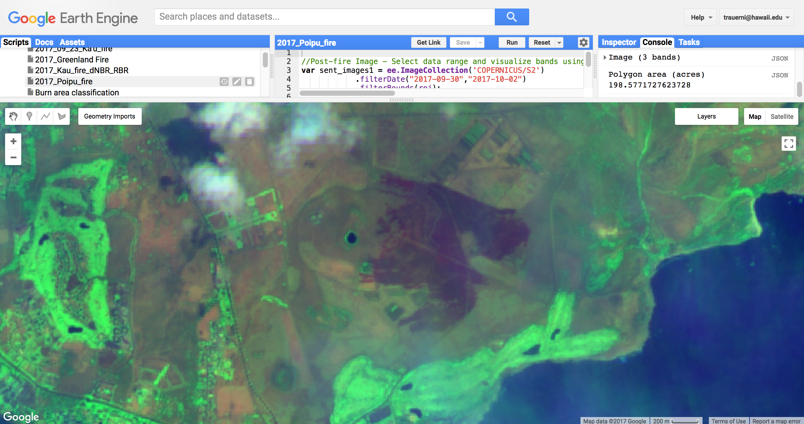
WUI, Ag & Forest
7/8/17 Waialua Mango Fire 377 acres
9/26/17 Poipu Fire 200 acres
10/9/17 Pulehu 1 (Central Maui) 107 acres
10/9/17 Pulehu 2 (Central Maui) 160 acres
10/9/17 Pulehu 3 (Central Maui) 170 acres
Land cover | Acres burned
Alien Forest | 1
Alien Shrubland | 40
Cultivated Lands | 43
Alien Grassland | 131

Slide 36
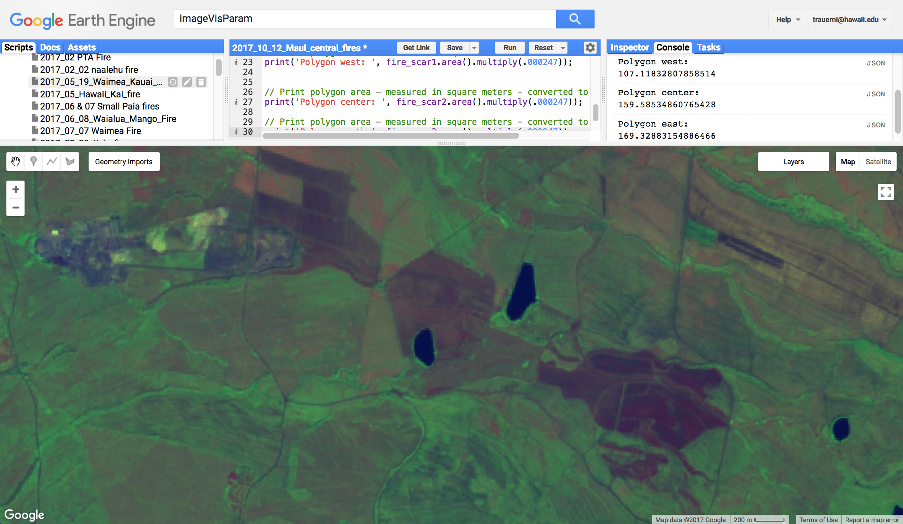
WUI, Ag & Forest
7/8/17 Waialua Mango Fire 377 acres
9/26/17 Poipu Fire 200 acres
10/9/17 Pulehu 1 (Central Maui) 107 acres
10/9/17 Pulehu 2 (Central Maui) 160 acres
10/9/17 Pulehu 3 (Central Maui) 170 acres
Land cover | Acres burned
Alien Grassland | 4
Alien Forest | 19
Cultivated Lands | 454

Slide 37
Discussion
- Lessons learned from response
- Resource vulnerability concerns
- Other concerns or questions?
Haena Fire, Kauai – 50 acres(?)

Slide 38
Upcoming events & related resources
2017 Hawaii Wildfire Summit – May 2-4 at Mauna Lani Resort
  www.hawaiiwildfire.org for details
PFX Research & Publications section (www.PacificFireExchange.org):
  Webinar: Fire Weather for Pacific Islands by Derek Wroe, Nat Weather Service
  Webinar: Land Cover Maps for Fire & Land Mgmt by Matt Lucas, UH-Manoa
  Fuels and Wildfire Behavior Training Module
  Pre-Fire Planning Guide for Hawaii and Pacific Islands
Don’t forget – please fill out the survey!
THANK YOU

