Slide 1
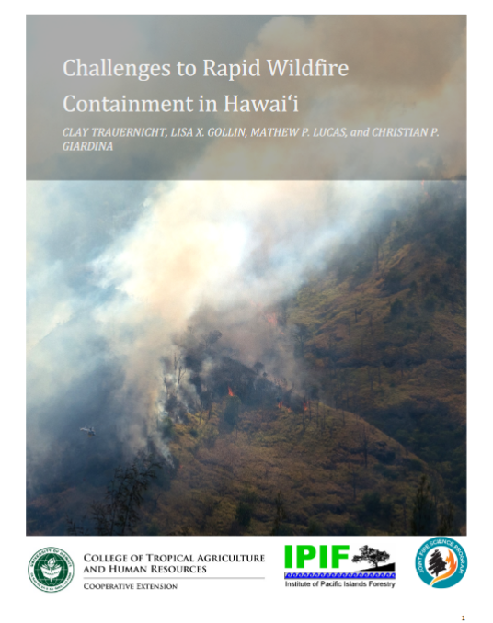
https://www.nrem-fire.org/challenges-to-rapid-wildfire-contai
Notes:
The multiple factors that led to last August's devastating and absolutely preventable “perfect” firestorm in Lahaina exposed to the world what the wildfire response and management community has known for a long time. For those of you who may not have read this study, I am blowing the ashes off of social science research for a report I did with Clay and others in 2015 on the Challenges to Rapid Wildfire Containment In Hawai‘i. The report can be found online.
In 2014 to 15 I conducted in-depth interviews with 14 Incident Commanders and fire managers and 1 fire science educator across the islands. Contributors were from County, State and Federal agencies and the Hawai‘i Community College Fire Science Program. The objectives of the project were to identify the primary challenges to rapid containment of wildfires in Hawaii and synthesize recommendations to improve the capacity of fire response agencies. I asked fire decision-makers about their experiences and recommendations on fire behavior, access issues, equipment and personnel, suppression practices, agency collaboration, use of online resources and more.
All interview participants identified firefighter safety as the top priority and stressed the importance and successful track record of interagency cooperation. Circa 2015 this was a very collaborative community, notwithstanding, limited personnel and equipment. Fire agencies worked together whenever a first response lacks the resources to contain a fire. Interisland and interagency collaboration provided opportunity for firefighters to share knowledge about changing fire regimes and iconic fires.

Slide 2
Notes:
What is not likely to be news to our steering committee hui, is what participants identified as the most significant challenges to wildfire response: The lack of available personnel and equipment, difficult terrain, high climatic variability, and novel fuel types, especially the predominance of nonnative grasses, etc. High wind speed and low relative humidity were identified by interview participants are the key drivers of large wildfires and were supported by analyses of weather and fire occurrence data. The majority of participants identified grassland expansion particularly into native habitats and the decline of ranching and agricultural operations as serious problems due to fuels accumulation and the decreased availability of critical resources such as water and bulldozers. One firefighter said that by the end of his career they would no longer be able to use old lava fields as fire breaks because they are increasingly colonized by ember-throwing fountain grass.

Slide 3
A FEW MAUI RESPONSES: LOCATION LOCATION LOCATION
We don’t even have to ask what the fuel type is if we know the location. Like if it’s at Lahaina Luna School, I know it’s in cane grass and that it’s going to hit the big trees eventually.
We can be on one ridge and the RH could be 20 and on the leeward side of the mountain the RH could be eight. And the winds could be coming from one way and another way. There can be so much variation one mile away from each other.
All the different agencies use different systems. Some of us use KBDI, some of us others. We should pick one predictive system so we’re in agreement. We can’t count on the RAWs data. Agree on this particular service so we are all talking about the same numbers or indicators (like “red” level). One program, one message. It’s a public outreach thing too. So we are using the same fire warning system.
Notes:
Prior site-specific knowledge of vegetation, weather, terrain, and fire behavior is key to initial attack and suppression. The following statement from a Maui participant was a typical response: “We don’t even have to ask what the fuel type is if we know the location. Like if it’s at Lahaina Luna School, I know it’s in cane grass and that it’s going to hit the big trees eventually.” These are a few examples from Maui.

Slide 4
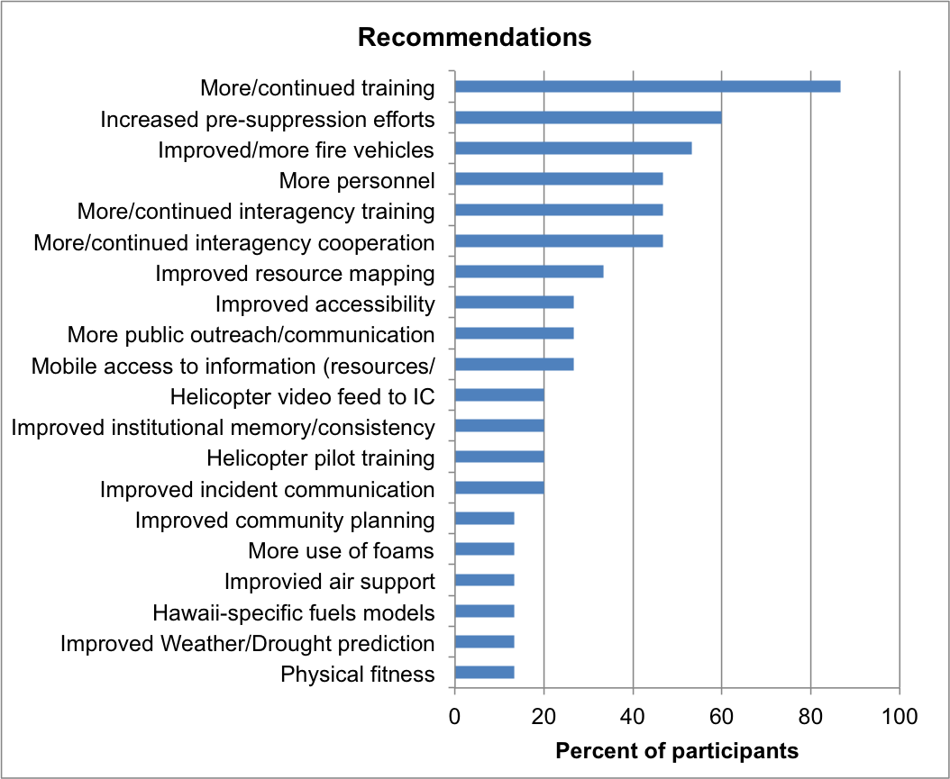
Notes:
The top recommendations to improve suppression capacity were to:
continue and increase wildland fire training opportunities for firefighters
increase pre-suppression efforts including fire and fuel breaks
landowner preparedness
resource mapping and,
increasing the availability of personnel and appropriate wildland equipment for suppression efforts.

Slide 5
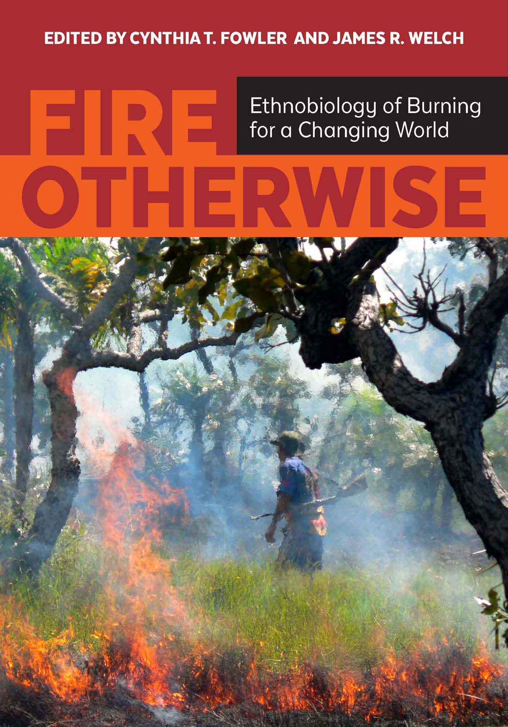
Notes:
In my interviews, I also explored whether firefighters used place-based knowledge to respond to and manage fire? Having worked with taro farmers, salt collectors and other cultural practitioners who stressed the growing unpredictability of gathering and managing resources tied to climate disruption, I wanted to know if and how climate disruptions might be perceived by our firefighters. Do firefighters use place-based knowledge to assess, mitigate and manage fire? How do firefighters perceive and respond to a rapidly changing environment? Is there an “oral history” of fire? I asked questions about:
Sensory cues used in fighting fire,
observations of the natural surroundings such as animal behavior,
fire behavior characteristics of invasive, fire-prone plants, particularly grasses
environmental changes (if any) observed over the course of the participant’s career?
I also asked how firefighters’ factor in protection of Hawaii’s bio-cultural diversity in fire mitigation and land management.
What emerged is that in the face of novel fire regimes, limited resources, and continental technological tools that don't always work for our island biogeography firefighters adapt using an amalgam of native and new environmental knowledge.
Two examples out of many
Several of the firefighters discussed the importance of knowing the diurnal wind patterns of an area. A “burn boss” described how he conducted a prescribed burn at Kawaihae Harbor. He consulted with older fishers. They told him within a couple of days of the new moon the winds die down at night -an ideal time for night fishing. He consulted the Hawaiian fishing calendar to plan a prescribed burn at night. On the day of burn, it was howling and into the evening. At 8pm (as per the calendar) the wind died down and they were able to execute a perfect burn.
There is an elaborate curing and burn taxonomy of invasive grasses. Turning fire science on its head, guinea grass, the most volatile of the invasives, is as dangerous alive as dead, can ignite in high humidity, and reburn leaving firefighters without the traditional safety zone or, “being into the black” to finish fighting the fire. By contrast, the native pili grass (which also likes fire), has a “slow, clean” burn.
Fuel sources have distinct smells. Mesquite smells like “sweet maple bacon,” the native naio has a pungent smell.
One great concern is that wildfire knowledge is not being passed down as a number of senior firefighters who comprise the “brain trust” of the wildfire-fighting community have recently retired. Fire-behavior modeling and weather forecasting tools should be customized for Hawaii’s new grass fire regimes and squirrely weather and micro-climates. Better natural and cultural resource mapping and monitoring is needed.

Slide 6
Notes:
] Should there be interest and time in next quarter's meeting, I can present a more in-depth discussion of the place-based environmental knowledge of Hawaii’s firefighters.
For now, and in particular post-August 2023's conflagration:
To what extent have the technological tools such as fire behavior modeling, real time weather, KBDI been improved and further adapted to our island biogeography?
To what extent has Hawaii's brain trust of fire institutional and environmental knowledge, now mostly retired, been passed on to today's fire leadership and ground pounders especially given that the new normal becomes more virulent.

